Slide 1
Hemoptysis
CLINID conference
Hunter Ratliff
02/20/2025
Ages, dates, and other identifying information may have been changed
I have no conflict of interest in relation to this presentation
Notes:
https://wvumdtv.zoom.us/j/4383197511?omn=93537052670

Slide 2
Case #1

Slide 3
Case 1: HPI
A 74 y/o M with PMH including DM, heavy smoking p/w

Slide 4
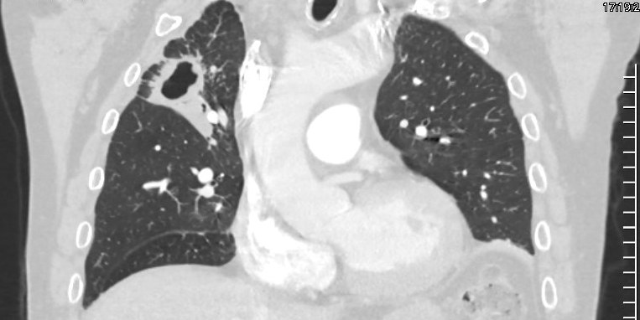
Case 1: HPI
A 74 y/o M with PMH including DM, heavy smoking p/w

Slide 5
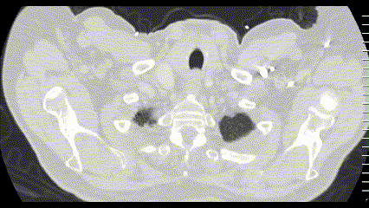
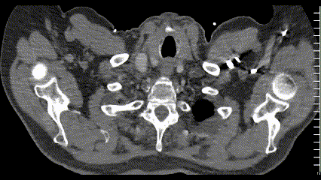
Case 1: HPI
A 74 y/o M with PMH including DM, heavy smoking p/w

Slide 6
Case 1: HPI
A 74 y/o M with PMH including DM, heavy smoking history
Usual state of health until 2 months ago, when was admitted for femur fracture
One month ago, worsening of his chronic cough
Had no dyspnea, faint hemoptysis
Cough got bad enough that finally sought medical care

Slide 7
Case 1: Social & Exposure History
Geographic & Travel | The patient lives in Ohio with his daughter on many acres of land He denies recent foreign or domestic travel Has never traveled to an endemic area for TB
Occupational | They are retired, but previously worked as a carpenter (including woodworking)
Substance & needles | They are a former heavy drinker (6 pack a day) Former 2 ppd smoker since age 12 (quit recently due to cough) No drugs No unprofessional piercings or tattoos
Animals | No farm animal exposures, bird/reptile exposures, or other animal exposure (aside from their pet dogs)
Exposures | Never been in or worked in: correctional facilities, homeless shelters, healthcare, group settings. No known contacts with TB Does work outside (before he got sick), unclear if any soil exposures

Slide 8
Case 1: HPI
A 74 y/o M with PMH including DM, heavy smoking
Usual state of health until 2 months ago, when was admitted for femur fracture
One month ago, worsening of his chronic cough
No dyspnea, faint hemoptysis
Cough got bad enough that finally sought medical care
Social / exposures
Rural Ohio
Former carpenter, including w/ wood
Former heavy EtOH & smoke
Only animal is dogs
No TB exposures
Hobbies: outdoors stuff
DDx?

Slide 9
Case 1: Early thoughts?
A 74 y/o M with PMH including DM, heavy smoking
Usual state of health until 2 months ago, when femur fracture
One month ago, worsening of his chronic cough
No dyspnea, faint hemoptysis
Cough progressed
Social / exposures
Rural Ohio
Former carpenter, including w/ wood
Former heavy EtOH & smoke
Only animal is dogs
No TB exposures
Hobbies: outdoors stuff
DDx?

Slide 10
Case 1: From the chart
A 74 y/o M with PMH including DM, heavy smoking
One month of cough, hemoptysis
Chart review
April 2021
RUL cavitary TB
s/p 30 weeks of RIPE
January 2024
Seen in our ED with faint hemoptysis
Discharged from ED

Slide 11
Case 1: From the patient
A 74 y/o M with PMH including DM, heavy smoking
One month of cough, hemoptysis
He states he was treated for TB, which was after he says he was first diagnosed a few years ago
He states he completed this initial course of treatment and was told that he was "cleared" from TB by his lung doctor
Chart review
April 2021
RUL cavitary TB
s/p 30 weeks of RIPE
January 2024
Seen in our ED with faint hemoptysis
Discharged from ED

Slide 12
Case 1: From the patient
A 74 y/o M with PMH including DM, heavy smoking
One month of cough, hemoptysis
Treated for TB once (2021)
Told by “lung doctor” he was "cleared" from TB
Chart review
April 2021
RUL cavitary TB
s/p 30 weeks of RIPE
January 2024
Seen in our ED with faint hemoptysis
Discharged from ED
Report some weight loss
Attributes to lifestyle changes after hip Fx
Past week:
Subjective fevers
Occasional night sweats
The day before admission:
Frank, large volume hemoptysis

Slide 13
Next step?
The health department!

Slide 14
Case 1: From the health dept (late on a Friday)
Kinda a late consult, but still called the health department before they closed
The health department immediately knew who the patient was
Even without providing any identifiers
Clinical pearl
After you say “I’m calling from Ruby”, if the health department’s TB director knows who your patient is without saying their name, this is pathognomonic for not leaving at 5pm

Slide 15
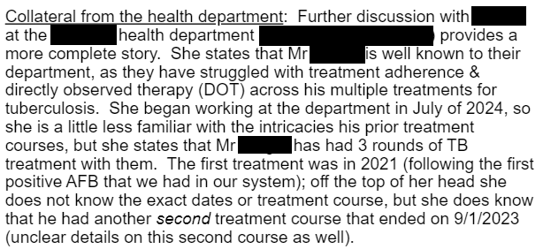
Case 1: From the health dept

Slide 16
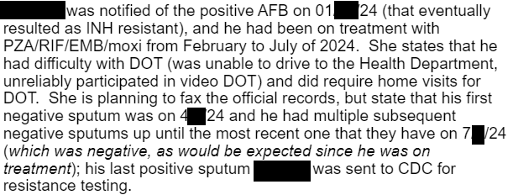
Case 1: From the health dept

Slide 17
Case 1: From the health dept

Slide 18
Case 1: Exam
Vitals: BP 130/66 | Pulse 78 | Temp 36.5 °C | SpO2 92% | BMI 28.18 kg/m²
Gen: alert and oriented, NAD, vitals reviewed
Head/Neck: NCAT; trachea appears midline, no gross LAD
ENT: EOMI grossly, anicteric sclerae; MMM
Resp: normal respiratory effort, frequently coughing with bedside container filled with bright red blood
CV: RRR; extremities perfused well
GI: non-distended; no TTP
Ext: no clubbing, cyanosis, or edema
Neuro: normal
At least 150 cc of bloody sputum in bedside container

Slide 19
Case 1: Prior micro
From the ED visit a years ago where he was discharged from the ED
April 2021 | MIC | Intrp
Ethambutol, low | 5 | S
Ethambutol, high | 8 | S
Isoniazid, low | 0.1 | S
Isoniazid, high | 0.4 | S
Pyrazinamide | 300 | S
Rifampin | 1 | S
Jan 2024 | Intrp
Ethambutol (5.0 mcg/mL) | S
Isoniazid (0.1 mcg/mL) | R
Isoniazid (0.4 mcg/mL) | R
Pyrazinamide | S
Rifampin (5.0 mcg/mL) | S

Slide 20
Case 1: Summary
April 2021
First treatment
30 weeks of RIPE (end 11/2021)
A 74 y/o M with PMH including DM, HTN, prior RUL cavitary TB (with multiple treatment courses), most recently incompletely treated with RIF/PZA/EMB/Moxi (02/2024 - 07/2024) who now presents with hemoptysis
June 2022
Second treatment (consecutively)
8 weeks of RIPE, (end 08/2022) →
28 weeks rifampin + INH (end 02/2023) →
26 weeks of RIPE + moxi (end 09/2023)
INH stopped in 03/2023 d/t resistance
Jan 2024
AFB (+) at WVU
Feb 2024
Third treatment
RIF/PZA/EMB/Mox (~5 months)
July 2024
Pt self d/c’ed treatment
And evaded health authorities
Femur Fx in October (unknown TB status to staff)
Nov 2024
Pulmonary symptoms begin (again)
Jan 2025
Current admission
Jan 2024
Ethambutol | S
Isoniazid | R
Pyrazinamide | S
Rifampin | S

Slide 21
Case 1: Summary
April 2021
First treatment
30 weeks of RIPE (end 11/2021)
A 74 y/o M with PMH including DM, HTN, prior RUL cavitary TB (with multiple treatment courses), most recently incompletely treated with RIF/PZA/EMB/Moxi (02/2024 - 07/2024) who now presents with hemoptysis
June 2022
Second treatment (consecutively)
8 weeks of RIPE, (end 08/2022) →
28 weeks rifampin + INH (end 02/2023) →
26 weeks of RIPE + moxi (end 09/2023)
INH stopped in 03/2023 d/t resistance
Jan 2024
AFB (+) at WVU
Feb 2024
Third treatment
RIF/PZA/EMB/Mox (~5 months)
July 2024
Pt self d/c’ed treatment
DDx?
Workup?
And evaded health authorities
Femur Fx in October (unknown TB status to staff)
Nov 2024
Pulmonary symptoms begin (again)
Jan 2025
Current admission
Jan 2024
Ethambutol | S
Isoniazid | R
Pyrazinamide | S
Rifampin | S

Slide 22
Case 1: Workup
BAL | Result
Routine Cx
Fungal / AFB
Asp GM
MTB PCR
PJP PCR
Serum / Urine | Result
Histo Ag
Blasto Ag
Crypto Ag
Fungitell
Asp GM

Slide 23
Case 1: Workup
BAL | Result
Routine Cx
Fungal / AFB
Asp GM
MTB PCR
PJP PCR
Serum / Urine | Result
Histo Ag | Neg
Blasto Ag | Neg
Crypto Ag | Neg
Fungitell | Neg
Asp GM | Neg

Slide 24
Case 1: Workup
BAL | Result
Routine Cx | Neg
Auramine smear | (+)
Asp GM | Neg
MTB PCR
PJP PCR | Neg
Serum / Urine | Result
Histo Ag | Neg
Blasto Ag | Neg
Crypto Ag | Neg
Fungitell | Neg
Asp GM | Neg

Slide 25
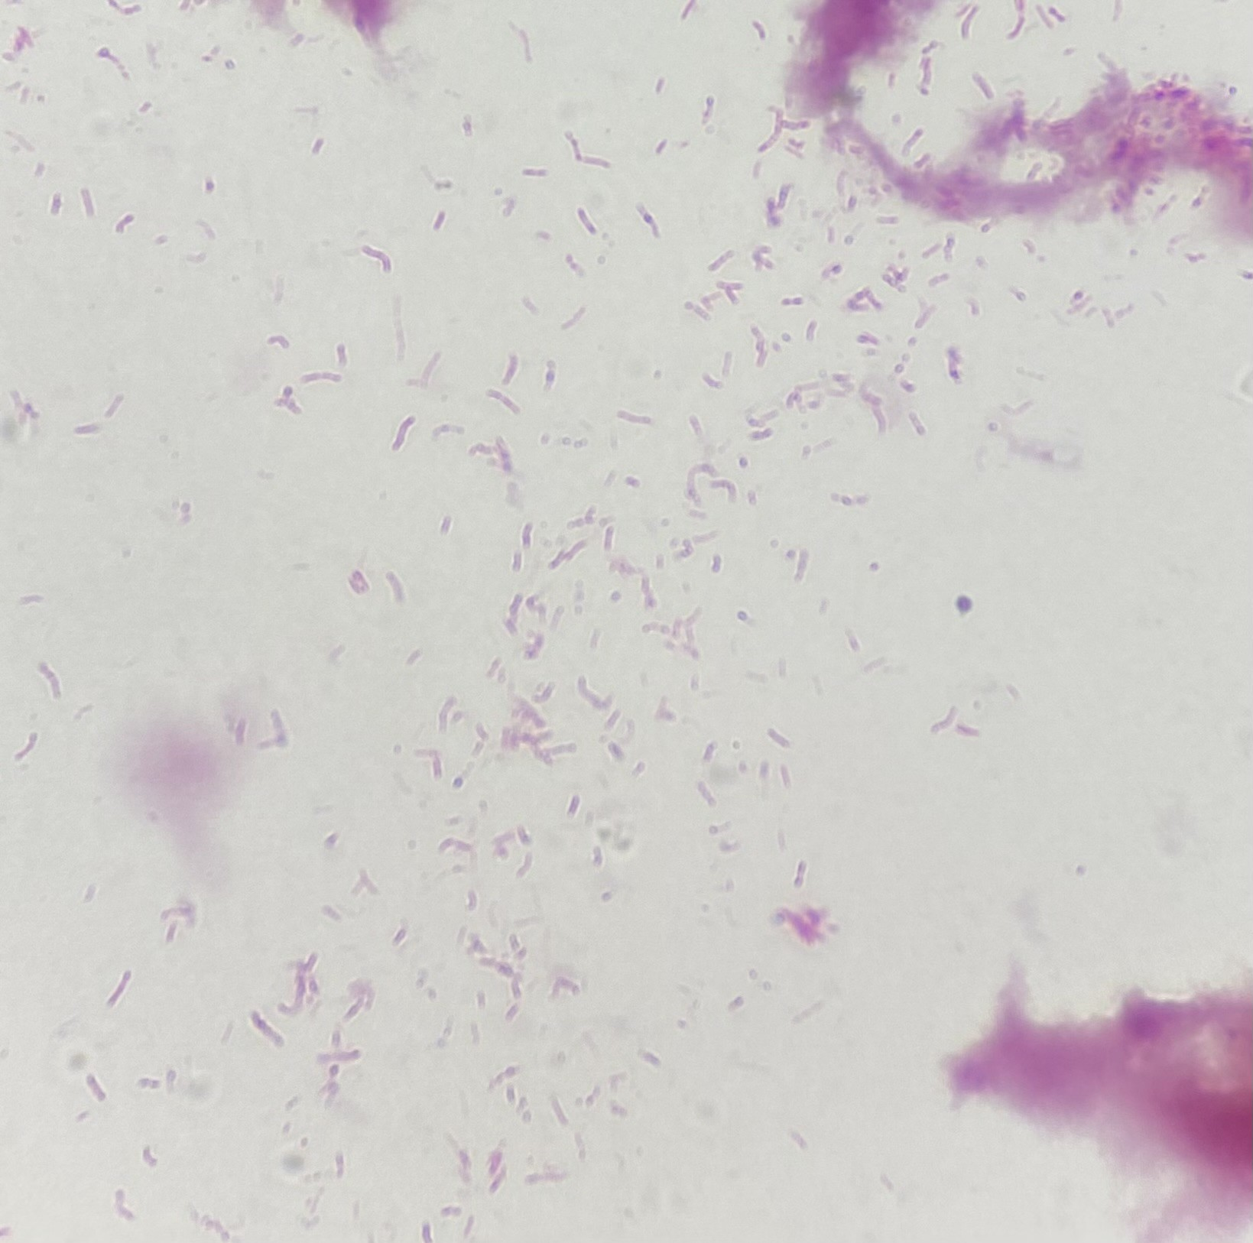
Case 1: Workup
BAL | Result
Routine Cx | Neg
Fungal / AFB | (+)
Asp GM | Neg
MTB PCR | (+)
PJP PCR | Neg

Slide 26
Case 1: Treatment
April 2021
First episode
30 weeks of RIPE (end 11/2021)
A 74 y/o M with PMH including DM, HTN, prior RUL cavitary TB (with multiple treatment courses), most recently incompletely treated with RIF/PZA/EMB/Moxi (02/2024 - 07/2024) who now presents with hemoptysis
June 2022
Second treatment (consecutive)
8 weeks of RIPE, (end 08/2022)
28 weeks rifampin + INH (end 02/2023)
26 weeks of RIPE + moxi (end 09/2023)
INH stopped in 03/2023 d/t resistance
Feb 2024
Third treatment
RIF/PZA/EMB/Mox (~5 months)
July 2024
Pt self d/c’ed treatment
How do we treat this?
Nov 2024
Pulmonary symptoms begin (again)
Jan 2025
Current admission
Jan 2024
Ethambutol | S
Isoniazid | R
Pyrazinamide | S
Rifampin | S

Slide 27
Case 1: Hospital course
Hosp day 3: Intubated for hemoptysis
Day 2: Started on daily
Rifampin 600 mg
Pyrazinamide 2 g
Ethambutol 1600 mg (15 mg/kg)
Levofloxacin 750 mg

Slide 28
Case 1: Hospital course
Hosp day 3: Intubated for hemoptysis
Day 4: Endobronchial blocker placed
Day 5: Severe bleeding, IR embolization of right bronchial artery
Day 2: Started on daily
Rifampin 600 mg
Pyrazinamide 2 g
Ethambutol 1600 mg (15 mg/kg)
Levofloxacin 750 mg
CT surgery
Deferred lobectomy until more stable

Slide 29
Case 1: Hospital course
Hosp day 3: Intubated for hemoptysis
Day 4: Endobronchial blocker placed
Day 5: Severe bleeding, IR embolization of right bronchial artery
Day 6: Endobronchial block removed, less bleeding
Day 7: Added INH, discussed bronchial valve
Day 2: Started on daily
Rifampin 600 mg
Pyrazinamide 2 g
Ethambutol 1600 mg (15 mg/kg)
Levofloxacin 750 mg
Day 7: added isoniazid 300
CT surgery
Deferred lobectomy until more stable
Pulmonology
Discussed bronchial valve

Slide 30
Case 1: Hospital course
Hosp day 3: Intubated for hemoptysis
Day 4: Endobronchial blocker placed
Day 5: Severe bleeding, IR embolization of right bronchial artery
Day 6: Endobronchial block removed, less bleeding
Day 10: Bleeding again, x2 endobronchial blockers
Day 13: Extubated
Day 18: Downgraded from MICU to floor
Day 2: Started on daily
Rifampin 600 mg
Pyrazinamide 2 g
Ethambutol 1600 mg (15 mg/kg)
Levofloxacin 750 mg
Day 7: added isoniazid 300
CT surgery
Deferred lobectomy until more stable
Pulmonology
Discussed bronchial valve

Slide 31
Case 1: Hospital course
Hosp day 3: Intubated for hemoptysis
Day 4: Endobronchial blocker placed
Day 5: Severe bleeding, IR embolization of right bronchial artery
Day 6: Endobronchial block removed, less bleeding
Day 10: Bleeding again, x2 endobronchial blockers
Day 13: Extubated
Day 18: Downgraded from MICU to floor
Day 21: Hypoxia, intubated and sent to MICU
Day 22: Severe shock, had GOC → CMO
Day 23: Expired
Day 2: Started on daily
Rifampin 600 mg
Pyrazinamide 2 g
Ethambutol 1600 mg (15 mg/kg)
Levofloxacin 750 mg
Day 7: added isoniazid 300
CT surgery
Deferred lobectomy until more stable
Pulmonology
Discussed bronchial valve

Slide 32
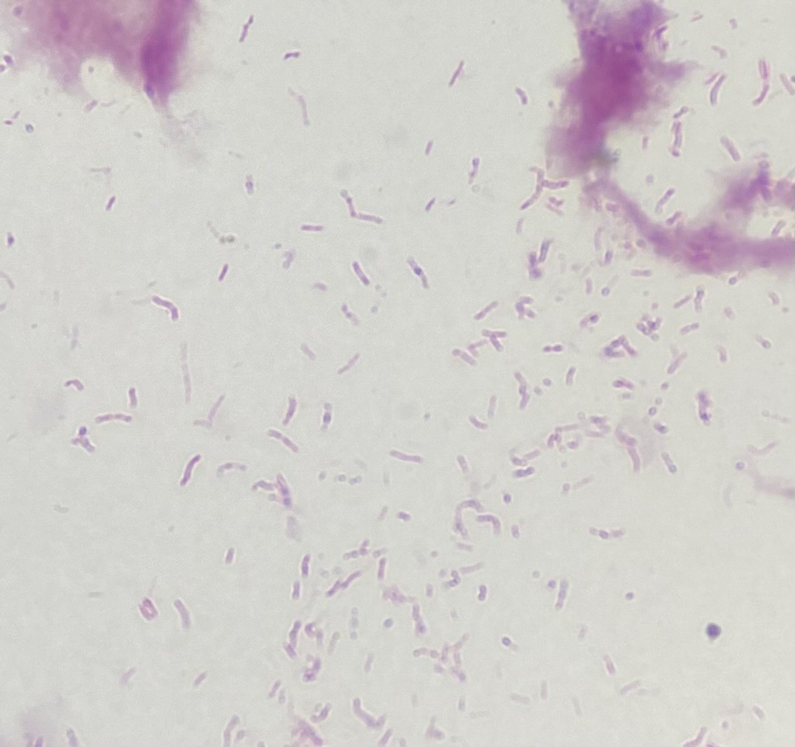
Nat Jewish Results
MDR TB line probe |  | Interpretation
rpoB | No mutations present | Suggests rifampin susceptibility
katG | No mutations present | Suggests susceptibility to isoniazid
inhA | No mutations present

Slide 33
Nat Jewish Results
MDR TB line probe |  | Interpretation
rpoB | No mutations present | Suggests rifampin susceptibility
katG | No mutations present | Suggests susceptibility to isoniazid
inhA | No mutations present

Slide 34
Nat Jewish Results
MDR TB line probe |  | Interpretation
rpoB | No mutations present | Suggests rifampin susceptibility
katG | No mutations present | Suggests susceptibility to isoniazid
inhA | No mutations present
This admission | Intrp
Ethambutol (5.0 mcg/mL) | S
Isoniazid (0.1 mcg/mL) | R
Isoniazid (0.4 mcg/mL) | R
Pyrazinamide | S
Rifampin (5.0 mcg/mL) | S

Slide 35
Discussion
Links to articles discussed here

Slide 36
Pulmonary tuberculosis
Review the history of M tuberculosis treatment
Describe the treatment for drug susceptible, INH resistant, & MRD TB
Compare the prior guidelines (2019) with the new 2025 ATS/CDC/ERS/IDSA guidelines
Discuss the role for surgical procedures in the treatment of MTB
Appraise the evidence for endobronchial valves

Slide 37
Review the history of tuberculosis & its treatment

Slide 38
From the history books
TB has been around a long time
Archeologists have found Egyptian mummies (2400 BC) with skeletal Pott’s lesions
In the Middle Ages, it was believed people could be cured from TB after a royal touch from a king or queen
During that time TB killed ~ 1 in 4 in Europe
1720: English physician Benjamin Marten proposed that TB was infectious in origin
1882: Dr. Robert Koch announced the discovery of Mycobacterium tuberculosis
Sanatorium Movement: Patients were treated with "rest cure" with fresh air & nutrition

Slide 39
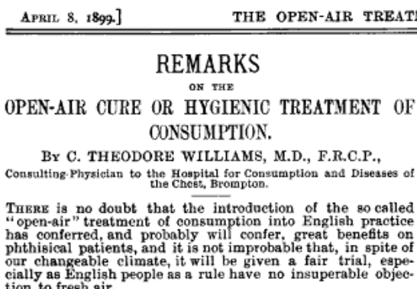

Slide 40
Hx of TB treatment: Surgicillin
Most of human history: Nothing, you died
Around 1900: First treatment for TB discovered and it was… surgery, not medicine
Specifically, inducing a pneumothorax

Slide 41
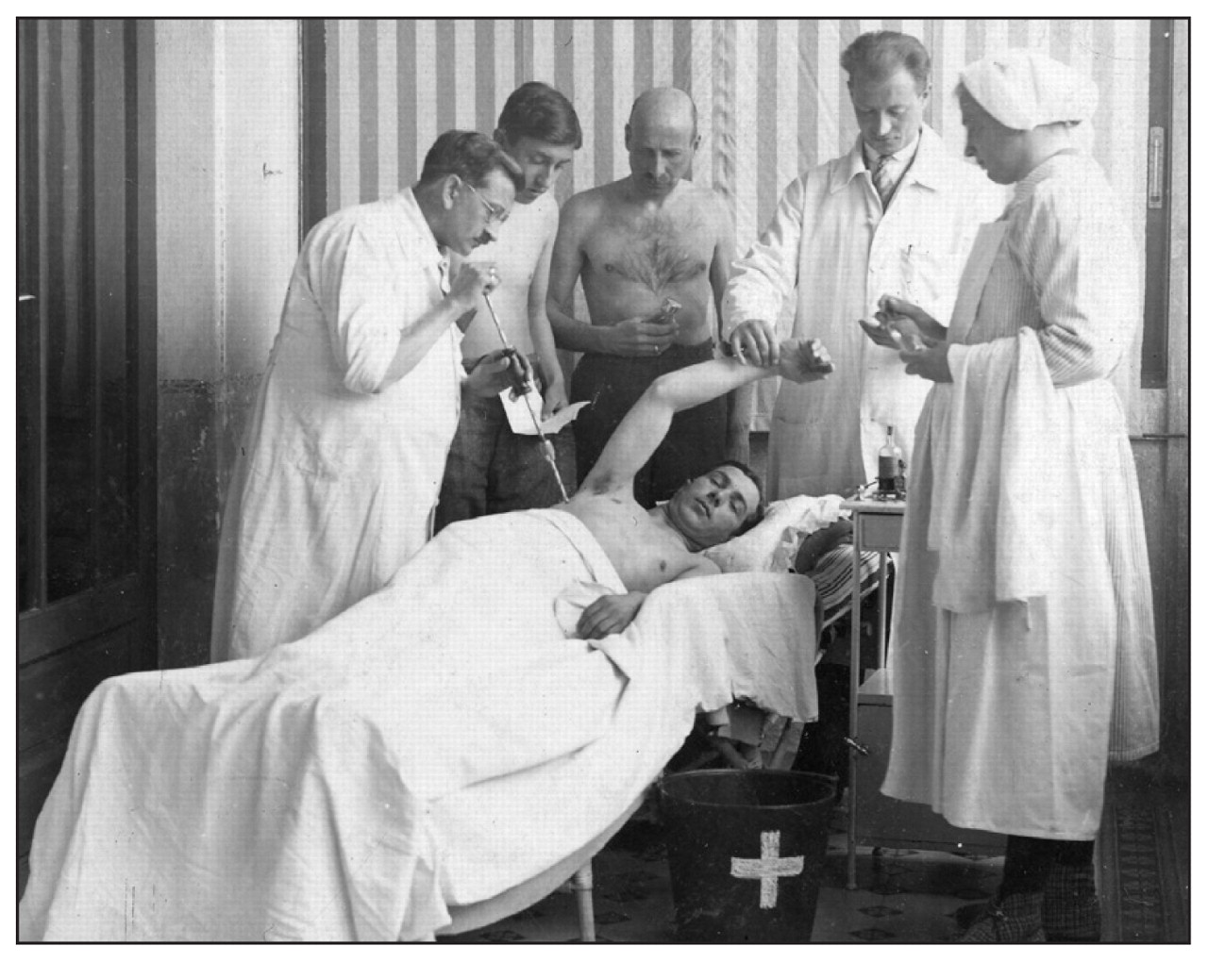
Hx of TB treatment: Surgicillin
Most of human history: Nothing, you died
Around 1900: Artificial pneumothorax
French physicians noted patients with spontaneous pneumothoraces improved
Recall that TB is an obligate aerobe, so it will die without oxygen
Of course, the procedure itself was quite risky
Pleurocentesis is performed while the patient is being monitored (circa 1930). Rakovich 2010 [1.1]

Slide 42
Hx of TB treatment: First antimycobacterials
Most of human history: Nothing, you died
Around 1900: Artificial pneumothorax (works because obligate aerobe)
1940s: First antimycobacterials discovered
Streptomycin (1943): did a good job, but rapid development of resistance developed
Was slowed when para-aminosalicylic acid (1946) was added

Slide 43
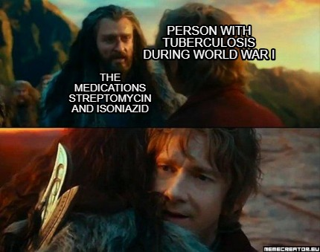
Hx of TB treatment: First antimycobacterials
Most of human history: Nothing, you died
Around 1900: Artificial pneumothorax (works because obligate aerobe)
1940s: First antimycobacterials discovered
Streptomycin (1943): did a good job, but rapid development of resistance developed
Slowed with para-aminosalicylic acid (1946)
Isoniazid (1952): Major breakthrough
Combination therapy with streptomycin + PAS + INH
allowed for cures (but still high failure rates)

Slide 44
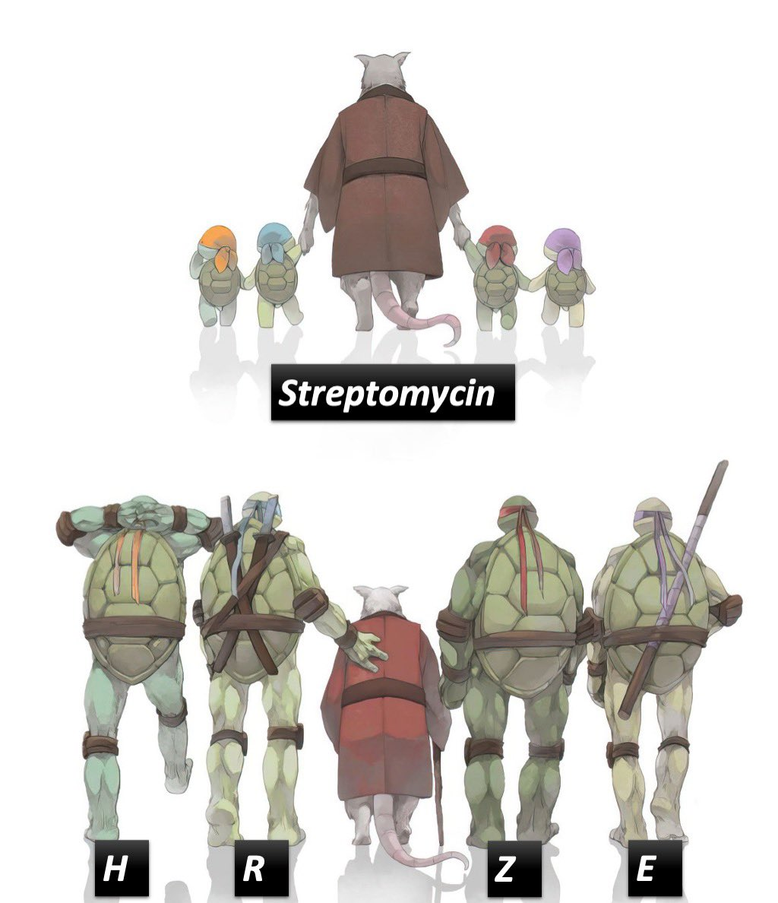
Hx of TB treatment: First antimycobacterials
Most of human history: Nothing, you died
Around 1900: Artificial pneumothorax (works because obligate aerobe)
1940s: First antimycobacterials discovered
Streptomycin (1943): did a good job, resistance developed
Slowed with para-aminosalicylic acid (1946)
Isoniazid (1952): Major breakthrough
Combination therapy with streptomycin + PAS + INH
allowed for cures (but still high failure rates)
Rifampin (1965): When used in combination therapy,
allowed for shorter duration
Decreased from 18 to 24 months → 6 - 9 months

Slide 45
Hx of TB treatment: First antimycobacterials
Most of human history: Nothing, you died
Around 1900: Artificial pneumothorax (works because obligate aerobe)
1940s: First antimycobacterials discovered
Streptomycin (1943): did a good job, resistance developed
Slowed with para-aminosalicylic acid (1946)
Isoniazid (1952): Major breakthrough
Combination therapy with streptomycin + PAS + INH
allowed for cures (but still high failure rates)
Rifampin (1965): When used in combination therapy,
allowed for shorter duration
Decreased from 18 to 24 months → 6 - 9 months
RIPE (AKA RIF/INH/PZA/EMB) has been standard
of care (for drug susceptible TB) since 1960s ^{[1.2]}

Slide 46
Hx of TB treatment: Modern era
Most of human history: Nothing, you died
Around 1900: Artificial pneumothorax (works because obligate aerobe)
1940 - 1960s: first antimycobacterials discovered, including streptomycin (1943), INH (1952), PZA (1954), EMB (1961), RIF (1965)
Since 1960s: RIPE has been standard of care (for drug susceptible TB)
1980s: Emergence of MRD-TB (resistant to RIF & INH) and later XDR-TB
Had to start using second line drugs (fluoroquinolones, aminoglycosides)
2010s: Novel TB drugs discovered
Bedaquiline (2012)
Delamanid (2014)
Pretomanid (2019)
Used in treatment for MDR-TB (BPaLM)
Abbreviations
RIF | Rifampin
INH | Isoniazid
PZA | Pyrazinamide
EMB | Ethambutol
RPT | Rifapentine
BDQ | Bedaquiline
Pa | Pretomanid
LZD | Linezolid
MOX | Moxifloxacin
LFX | Levofloxacin

Slide 47
Treatment of pulmonary tuberculosis
Review the history of M tuberculosis treatment
Describe the treatment for
Drug susceptible TB
INH resistant TB
MRD TB
Compare the prior (2019) guidelines with the new 2025 ATS/CDC/ERS/IDSA guidelines
Discuss the role for surgical procedures in the treatment of MTB
Appraise the evidence for endobronchial valves
We’ll save XDR-TB for another day

Slide 48
Current* treatment for DS pulmonary TB ^{[3.1 - CDC]}
Cavitary lesion –and– positive culture at 2 months
2HRZE followed by 7HR
Drug susceptible cavitary & Cx+
1 | 2 | 3 | 4 | 5 | 6 | 7 | 8 | 9
INH RIF PZA EMB |  | INH RIF
Abbreviations
RIF | Rifampin
INH | Isoniazid
PZA | Pyrazinamide
EMB | Ethambutol

Slide 49
Current* treatment for DS pulmonary TB ^{[3.1 - CDC]}
Cavitary lesion –and– positive culture at 2 months
2HRZE followed by 7HR
None of Box 1
2HRZE followed by 4HR
Consider extension (Box 1)
Cavitary lesion
Positive Cx @ 2 mo
Smoker
Underweight
Diabetes
HIV / immunosuppression
Extensive disease
Drug susceptible non-cavitary
Drug susceptible cavitary & Cx+
1 | 2 | 3 | 4 | 5 | 6 | 7 | 8 | 9
INH RIF PZA EMB |  | INH RIF
 |  | INH RIF
Abbreviations
RIF | Rifampin
INH | Isoniazid
PZA | Pyrazinamide
EMB | Ethambutol

Slide 50
Current* treatment for DS pulmonary TB ^{[3.1 - CDC]}
Cavitary lesion –and– positive culture at 2 months
2HRZE followed by 7HR
None of Box 1
2HRZE followed by 4HR
At least 1 of Box 1
2HRZE followed by 4HR
Consider extension of 4HR to 7HR
Consider extension (Box 1)
Cavitary lesion
Positive Cx @ 2 mo
Smoker
Underweight
Diabetes
HIV / immunosuppression
Extensive disease
Drug susceptible non-cavitary
Drug susceptible cavitary & Cx+
1 | 2 | 3 | 4 | 5 | 6 | 7 | 8 | 9
INH RIF PZA EMB |  | INH RIF |  |  |  | +/- INH & RIF
 |  | INH RIF
Abbreviations
RIF | Rifampin
INH | Isoniazid
PZA | Pyrazinamide
EMB | Ethambutol

Slide 51
INH-Resistant pulmonary TB ^{[1.5] 2019 guidelines}
Monoresistance to INH is frequent (8% worldwide)
6 months of RIF / PZA / EMB –plus– fluoroquinolone (MOX, LFX)
In select cases, can drop PZA after 2 months
Noncavitary + low burden of disease or PZA toxicity
Abbreviations
RIF | Rifampin
INH | Isoniazid
PZA | Pyrazinamide
EMB | Ethambutol
MOX | Moxifloxacin
LFX | Levofloxacin

Slide 52
INH-Resistant pulmonary TB ^{[1.5] 2019 guidelines}
Monoresistance to INH is frequent (8% worldwide)
6 months of RIF / PZA / EMB –plus– fluoroquinolone (MOX, LFX)
In select cases, can drop PZA after 2 months
Noncavitary + low burden of disease or PZA toxicity
Drug susceptible non-cavitary
Drug susceptible cavitary & Cx+
INH-R pulm TB
1 | 2 | 3 | 4 | 5 | 6 | 7 | 8 | 9
INH RIF PZA EMB |  | INH RIF |  |  |  | +/- INH & RIF
 |  | INH RIF
RIF MOX/LFX EMB |  |  |  |  |  | Consider extension if cavitary or Cx+ at 2 months
PZA |  | +/- PZA
Abbreviations
RIF | Rifampin
INH | Isoniazid
PZA | Pyrazinamide
EMB | Ethambutol
MOX | Moxifloxacin
LFX | Levofloxacin

Slide 53
MDR pulmonary TB ^{[1.5] 2019 guidelines}
Abbreviations
RIF | Rifampin
INH | Isoniazid
PZA | Pyrazinamide
EMB | Ethambutol
RPT | Rifapentine
BDQ | Bedaquiline
Pa | Pretomanid
LZD | Linezolid
MOX | Moxifloxacin
LFX | Levofloxacin
MDR-TB: Resistance to rifampin +/- resistance to INH
Prior guidelines suggested:
WHO “short course”
4-6 months
All of below each day!!!
Bedaquiline (BDQ)
MOX or LFX
PZA
EMB
High dose INH
Ethionamide
Clofazimine
5 months
MOX or LFX
PZA
EMB
Clofazimine
Longer combos
5 or more drugs
Ex: MOX + BDQ + LZD + Clofazimine + Cycloserine
5-7 months from neg Cx
4 or more drugs
15-21 months from neg Cx

Slide 54
Treatment for TB: Pill burden
Standard treatment for drug susceptible TB is 466 (6 mo) to 650 (9 mo) doses*
Our patient had approximately 8300 doses* over 113 weeks
Drug susceptible non-cavitary
Drug susceptible cavitary & Cx+
1 | 2 | 3 | 4 | 5 | 6 | 7 | 8 | 9
INH RIF PZA EMB |  | INH RIF |  |  |  | +/- INH & RIF
 |  | INH RIF
*Note
This is just a ballpark estimate, since one dose may actually be more pills (e.g. one dose of PZA for him is multiple pills)
He also didn’t take all of his pills, but regardless, this is a lot of meds

Slide 55
Treatment for TB: Pill burden
Patient Perspective ^{[1.3]}
“For individuals living with tuberculosis, the path from diagnosis to recovery is full of many challenges… The difficulty of high pill burden, medication side effects and long treatment regimens is frequently discussed by TB survivors in We Are TB support meetings. During my own treatment I felt the weight of 16 pills in my hand every morning, and of stigma, financial cost and isolation… Progress to shorten this journey and to ease these burdens is valued by patients.”
Kelly Holland, We Are TB patient advocate

Slide 56
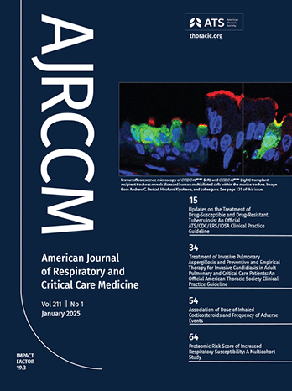
Updates on the Treatment of Drug-Susceptible and Drug-Resistant Tuberculosis ^{[1.3]}
An Official ATS/CDC/ERS/IDSA Clinical Practice Guideline (Jan 2025)

Slide 57
2025 guidelines^{[1.3]}: Shorter course of treatment?
Patients: In adults/adolescents with drug-susceptible pulmonary TB
Intervention: 4-month regimen (2HPZM / 2HPM)
2 months: INH, rifaPentine, PZA, Moxifloxacin –followed by–
2 months: INH, rifaPentine, Moxifloxacin
Comparison: 6 month regimen (2HRZE / 4HR), standard of care
2 months: INH / RIF / PZA / EMB –followed by–
4 months: INH / RIF
Outcome: Safety and efficacious
Abbreviations
RIF | Rifampin
INH | Isoniazid
PZA | Pyrazinamide
EMB | Ethambutol
RPT | Rifapentine
MOX | Moxifloxacin
Abbreviations
RIF | Rifampin
INH | Isoniazid
PZA | Pyrazinamide
EMB | Ethambutol
RPT | Rifapentine
MOX | Moxifloxacin
 |  | 1 | 2 | 3 | 4 | 5 | 6
INH |  | INH |  |  |  | INH
RIF |  | RIF |  |  |  | RIF
PZA |  | PZA
EMB |  | EMB
INH |  | INH
RPT |  | RPT
PZA |  | PZA
MOX |  | MOX

Slide 58
2025 guidelines^{[1.3]}: Shorter course of treatment?
Patients: In adults/adolescents with drug-susceptible pulmonary TB
Intervention: 4-month regimen (2HPZM / 2HPM)
2 months: INH, rifaPentine, PZA, Moxifloxacin –followed by–
2 months: INH, rifaPentine, Moxifloxacin
Comparison: 6 month regimen (2HRZE / 4HR), standard of care
2 months: INH / RIF / PZA / EMB –followed by–
4 months: INH / RIF
Outcome: Safety and efficacious
Abbreviations
RIF | Rifampin
INH | Isoniazid
PZA | Pyrazinamide
EMB | Ethambutol
RPT | Rifapentine
MOX | Moxifloxacin
Abbreviations
RIF | Rifampin
INH | Isoniazid
PZA | Pyrazinamide
EMB | Ethambutol
RPT | Rifapentine
MOX | Moxifloxacin
Recommendation: 2HPZM / 2HPM
Conditional recommendation, moderate certainty of evidence

Slide 59
Dorman et al (2021) ^{[1.4]}
Abbreviations
RIF | Rifampin
INH | Isoniazid
PZA | Pyrazinamide
EMB | Ethambutol
RPT | Rifapentine
MOX | Moxifloxacin
Based largely off of large RTC (13 countries, 34 sites) published in NEJM (2021)
All had culture confirmed susceptibility to INH, rifampin, & fluoroquinolones
Non-inferiority study: 84.6% were cured (vs. 85.4% in control)
P: Adults with susceptible pulm TB
I: 2HPZM / 2HPM
C: 2HRZE / 4HR
O: Safety & efficacious

Slide 60
Dorman et al (2021) ^{[1.4]}
P: Adults with susceptible pulm TB
I: 2HPZM / 2HPM
C: 2HRZE / 4HR
O: Safety & efficacious
Abbreviations
RIF | Rifampin
INH | Isoniazid
PZA | Pyrazinamide
EMB | Ethambutol
RPT | Rifapentine
MOX | Moxifloxacin
Found no significant differences in outcomes were identified for 4 mo RPT-MOX and 6 mo SoC on the basis of:
Smear grade
Cavitation
Radiologic extent

Slide 61
Dorman et al (2021) ^{[1.4]}
P: Adults with susceptible pulm TB
I: 2HPZM / 2HPM
C: 2HRZE / 4HR
O: Safety & efficacious
Abbreviations
RIF | Rifampin
INH | Isoniazid
PZA | Pyrazinamide
EMB | Ethambutol
RPT | Rifapentine
MOX | Moxifloxacin
Found no significant differences in outcomes were identified for 4 mo RPT-MOX and 6 mo SoC on the basis of:
Smear grade
Cavitation
Radiologic extent
 |  |  |  |  | 1 | 2 | 3 | 4 | 5 | 6 | 7 | 8 | 9
Standard of care |  |  | INH |  | INH |  |  |  | INH |  | +/- INH
 |  |  | RIF |  | RIF |  |  |  | RIF |  | +/- RIF
 |  |  | PZA |  | PZA
 |  |  | EMB |  | EMB
New way? |  |  | INH |  | INH
 |  |  | RPT |  | RPT
 |  |  | PZA |  | PZA
 |  |  | MOX |  | MOX

Slide 62
Dorman et al (2021) ^{[1.4]}
P: Adults with susceptible pulm TB
I: 2HPZM / 2HPM
C: 2HRZE / 4HR
O: Safety & efficacious
Abbreviations
RIF | Rifampin
INH | Isoniazid
PZA | Pyrazinamide
EMB | Ethambutol
RPT | Rifapentine
MOX | Moxifloxacin
Found no significant differences in outcomes were identified for 4 mo RPT-MOX and 6 mo SoC on the basis of:
Smear grade
Cavitation
Radiologic extent
Age - Most were <35 yo
Diabetes - Not well represented
Body weight - Not well represented
HIV status (8% were people living with HIV)

Slide 63
Dorman et al (2021) ^{[1.4]}
Abbreviations
RIF | Rifampin
INH | Isoniazid
PZA | Pyrazinamide
EMB | Ethambutol
RPT | Rifapentine
MOX | Moxifloxacin
Consideration of FQ toxicity: In the US, our folks with TB are older (compared to the trial) and have more comorbidities, QT prolonging meds, and risk of FQ toxicity
Reduced ocular complications: Because RPT-MOX avoids the potential ocular toxicity of EMB
Also clears sputum Cx faster
Higher pill burden: RPT-MOX regimen increases daily pill burden, especially compared with fixed-dose combinations
But shorter duration: 4 months (vs 9 mo) for cavitary TB
Used DOT: As it the case for many trials
INH-monoresistance: Doesn’t apply, excluded from the study
P: Adults with susceptible pulm TB
I: 2HPZM / 2HPM
C: 2HRZE / 4HR
O: Safety & efficacious

Slide 64
2025 guidelines^{[1.3]}: Shorter courses for MDR
Abbreviations
RIF | Rifampin
INH | Isoniazid
PZA | Pyrazinamide
EMB | Ethambutol
RPT | Rifapentine
BDQ | Bedaquiline
Pa | Pretomanid
LZD | Linezolid
MOX | Moxifloxacin
LFX | Levofloxacin
Patients: In adults/adolescents with rifampin-resistant pulmonary TB
Also includes those intolerant of rifampin
Intervention: 6-month regimen BPaL(M)
Bedaquiline 400 daily x 2 wk, then 200 x3/week
Pretomanid 200 daily
Linezolid 600 daily
Moxifloxacin 400 daily (if susceptible)
Comparison: 15+ month regimen (2019 guidelines), standard of care
Outcome: Safety and efficacious

Slide 65
2025 guidelines^{[1.3]}: Shorter courses for MDR
Abbreviations
RIF | Rifampin
INH | Isoniazid
PZA | Pyrazinamide
EMB | Ethambutol
RPT | Rifapentine
BDQ | Bedaquiline
Pa | Pretomanid
LZD | Linezolid
MOX | Moxifloxacin
LFX | Levofloxacin
Patients: In adults/adolescents with rifampin-resistant pulmonary TB
Also includes those intolerant of rifampin
Intervention: 6-month regimen BPaL(M)
Bedaquiline 400 daily x 2 wk, then 200 x3/week
Pretomanid 200 daily
Linezolid 600 daily
Moxifloxacin 400 daily (if susceptible)
Comparison: 15+ month regimen (2019 guidelines), standard of care
Outcome: Safety and efficacious
Recommendation: BPaL(M)
Strong recommendation, very low certainty of evidence

Slide 66
2025 guidelines^{[1.3]}: Shorter courses for MDR
Abbreviations
RIF | Rifampin
INH | Isoniazid
PZA | Pyrazinamide
EMB | Ethambutol
RPT | Rifapentine
BDQ | Bedaquiline
Pa | Pretomanid
LZD | Linezolid
MOX | Moxifloxacin
LFX | Levofloxacin
Based off of TB-PRACTECAL trial (2022) & ZeNix (2022) vs observational data
ZeNix trial: Compared to WHO data (SoC), BPaL had
Higher treatment success (100% vs. 74%)
Lower mortality (0% vs. 11%)
Higher grade 3+ adverse events (14% vs 5%) ?reporting bias
TB-PRACTECAL: Compared to SoC, BPaL had
Higher treatment success (77% vs. 52%)
Lower grade 3+ adverse events (20% vs 51%)
P: Adults with INH-R TB
I: 6BPaL(M)
C: 15+ months SoC
O: Safety & efficacious

Slide 67
Surgical treatment
for pulmonary tuberculosis
Review the history of M tuberculosis treatment
Describe the treatment for drug susceptible, INH resistant, & MRD TB
Compare the prior (2019) guidelines with the new 2025 ATS/CDC/ERS/IDSA guidelines
Discuss the role for surgical procedures in the treatment of MTB
Appraise the evidence for endobronchial valves

Slide 68
Surgi-cillin for TB: 2019 ATS/CDC/ERS/IDSA ^{[1.5]}
For adults with MDR-TB receiving antimicrobial therapy, they suggest elective partial lung resection (lobectomy or wedge resection) vs medical therapy alone
Conditional recommendation, very low certainty in the evidence

Slide 69
Surgi-cillin for TB: 2019 ATS/CDC/ERS/IDSA ^{[1.5]}
For adults with MDR-TB receiving antimicrobial therapy, they suggest elective partial lung resection (lobectomy or wedge resection) vs medical therapy alone
Conditional recommendation, very low certainty in the evidence
Difficult topic to do meta-analysis on
Partial lung resection had a higher probability of treatment success (aOR: 3.0; 95% CI, 1.5–5.9), as opposed to treatment failure, relapse, or death
Treatment success in XDR-TB was lower in patients who had surgery (aOR: 0.4; 95% CI, 0.2–0.9)
Committee believed partial lung resection would be of net benefit for patients with strong risk of relapse
Similar to 2016 WHO guidelines

Slide 70
Endobronchial valves
Much like pneumothoraces, surgical resection has high rates of complications
There might be another answer

Slide 71
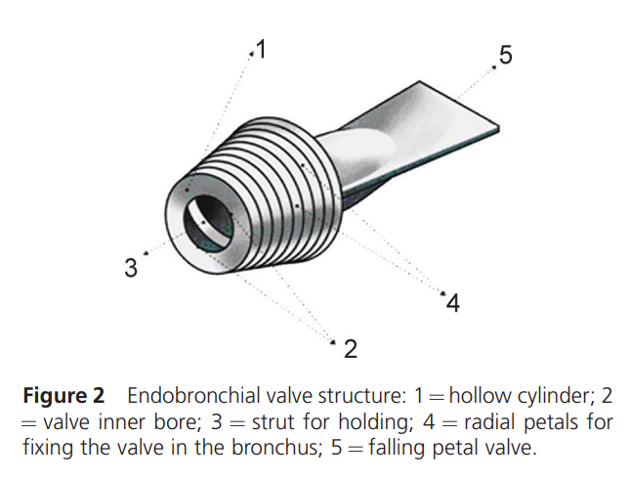
Endobronchial valves
Much like pneumothoraces, surgical resection has high rates of complications
There might be another answer
Enter: Endobronchial valves!

Slide 72
Endobronchial valves (EbV)
First reports (that I could find) were in 2016
But they had been used in Russia for longer
Placed by interventional pulmonology during bronchoscopy
Can easily be removed if needed
Works by collapsing the cavity
History of TB treatment
Before times: Nothing
Around 1900: Artificial pneumothorax
1940-60s: antimycobacterials
Now: Endobronchial valves

Slide 73
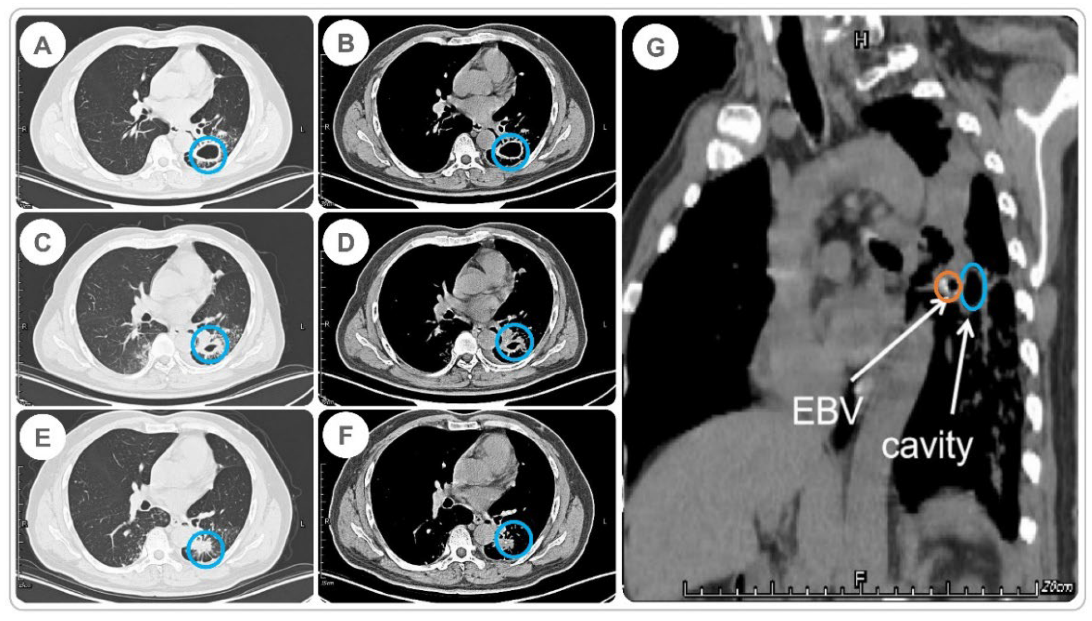

Slide 74
Levin et al (2016) ^{[1.6]}
First RCT, based out of Russia (n=102) with MRD-TB
Only side effect was cough
Within first 3 months of study, 47 patients in the intervention group cleared their cultures (96%), compared to 20 (38%) of controls (p<0.0001)

Slide 75
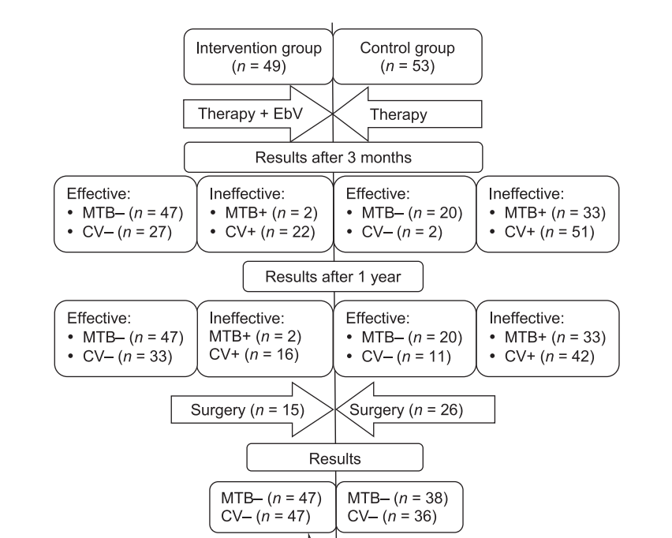
Levin et al (2016) ^{[1.6]}
CV = cavity closure

Slide 76
Levin et al (2016) ^{[1.6]}

Slide 77
An et al (2022) ^{[1.7]}
Case series of 35 patients with MDR-TB in China who received EbV

Slide 78
An et al (2022) ^{[1.7]}
Case series of 35 patients with MDR-TB in China who received EbV
100% cleared sputum cultures
Cavity closure rate was 68.8%

Slide 79
An et al (2022) ^{[1.7]}
Case series of 35 patients with MDR-TB in China who received EbV
100% cleared sputum cultures
Cavity closure rate was 68.8%
Strong association between
Cavity closure –and–
Clearance of sputum cultures

Slide 80
Learning points & take aways

Slide 81
Learning points & take aways
Treatment for pulmonary TB carries a heavy pill burden, which may influence compliance
Rifampin, isoniazid, pyrazinamide, & ethambutol (2HRZE/4-7HR aka “RIPE”) has been the mainstay for pulmonary TB since the 1960s
Historically, treatment was extended from 6 → 9 months in the case of severe/cavitary disease
Drug susceptible TB: Newer evidence suggests that a shorter, 4 month, course of INH/rifapentine/PZA/moxi (2HPZM / 2HPM) may be appropriate
Regardless of smear grade, cavitation, or radiographic extent
Conditional recommendation, moderate certainty
MDR TB: 6 months BPaL(M) preferred over 15+ months standard of care
Strong recommendation, very low certainty
Elective partial lung resection should be considered in MDR-TB with strong risk of relapse
Endobronchial valves may provide a non-invasive, safer way to achieve the same aims (almost no data though)
Slides available on hunterratliff1.com/talk/; Citations available via QR code or via the “citations” button on the website

Slide 82
Case #2
Time permitting, but it’s short

Slide 83
Case 2: HPI
A 57 y/o M with PMH including left knee MRSA PJI, recent RLE osteomyelitis, ESRD on PD presents to clinic for TB evaluation
One year ago, his left TKA has MRSA PJI
Dapto/RIF → doxy suppression
6 months ago, had osteomyelitis of right first toe
2 weeks dapto/Zosyn → 4 weeks Zyvox & moxifloxacin (avoid OPAT in case needs HD in future)

Slide 84
Case 2: HPI
A 57 y/o M with PMH including left knee MRSA PJI, recent RLE osteomyelitis, ESRD on PD presents to clinic for TB evaluation
One year ago, his left TKA has MRSA PJI
Dapto/RIF → doxy suppression
6 months ago, had osteomyelitis of right first toe
2 weeks dapto/Zosyn → 4 weeks Zyvox & moxifloxacin (avoid OPAT in case needs HD in future)
During malignancy workup (for cough & weight loss), found to have cavitary nodule
External records from 15 months ago showed lesion in same area, slightly increased in size
PPD 19mm

Slide 85
Case 2: Not real
A 57 y/o M with PMH including left knee MRSA PJI, recent RLE osteomyelitis, ESRD on PD presents to clinic for TB evaluation
One year ago, his left TKA has MRSA PJI
Dapto/RIF → doxy suppression
6 months ago, had osteomyelitis of right first toe
2 weeks dapto/Zosyn → 4 weeks Zyvox & moxifloxacin (avoid OPAT in case needs HD in future)
During malignancy workup (for cough & weight loss), found to have cavitary nodule
External records from 15 months ago showed lesion in same area, slightly increased in size
PPD 19mm
Not a real case
(at least yet)
Takeaway
Ask about TB risk factors
Only treat TB when you are intending to treat TB
Note
This scenario might cause pre-XDR TB. Zyvox resistance is rare

