Slide 1
PEP Rally
CLINID conference
Hunter Ratliff
04/17/2025
Ages, dates, and other identifying information may have been changed
I have no conflict of interest in relation to this presentation

Slide 2
Case #1

Slide 3
Case 1: HPI
A 50 y/o F with PMH including hypothyroidism, ADHD p/w a needle stick injury

Slide 4
Case 1: HPI
A 50 y/o F with PMH including hypothyroidism, ADHD p/w a needle stick injury
Works in the at WVU, had injury while disposing of 18 gauge needle
Punctured the glove on her finger
Developed bleeding after injury
Source patient HIV (+)
Terms
Exposed patient = healthcare worker with needlestick injury
Source patient = patient whose blood the healthcare worker was exposed to

Slide 5
Case 1: Poll
Immediate next steps (right after the needle stick)?
What labs should be done on the exposed patient?
What do you want to know about the source patient?
A 50 y/o F with PMH including hypothyroidism, ADHD p/w a needle stick injury
18 gauge needle to finger
Immediate bleeding

Slide 6
Case 1: Immediate next steps
Exposed pt | Result
HIV (4G) | Neg
HCV | Neg
Anti-HBs | 0.25
HBsAg | Neg
Anti-HBc | Neg
The exposed patient washed the injured area with soap and water
She was already in the ED (at time of needle stick), so labs were obtained
At time of needle stick, source patient had already left the ED
Exposed pt | Result
CBC | Normal
Creatinine | 0.8
Alk phos | 114
AST | 21
ALT | 10
Bili | 0.7
uPreg test | Neg
Home meds
Levothyroxine
Vyvanse
Ozempic

Slide 7
Case 1: Source patient
The source patient follows in our clinic
Diagnosed 2005
RF: MSM & substance use (sober for 8 years)
No resistance
Biktarvy since 2018
Date | HIV VL
-7 mo | TND
-1 yr | 39
-1.5 yr | <20
-2 yr | <20
-2.5 yr | 49
-3 yr | <20
Labs (2013) | Result
HCV | Neg
Anti-HBs | >40
HBsAg | Neg
Anti-HBc | Reactive

Slide 8
Case 1: Poll
A 50 y/o F with PMH including hypothyroidism, ADHD p/w a needle stick injury from source patient with HIV
Should she get PEP for HIV?
What should be done for PEP
Exposed pt | Result
HIV (4G) | Neg
HCV | Neg
Anti-HBs | 0.25
HBsAg | Neg
Anti-HBc | Neg
Source | HIV VL
-7 mo | TND
-1 yr | 39
-1.5 yr | <20
-2 yr | <20
-2.5 yr | 49
-3 yr | <20
Labs (2013) | Result
HCV | Neg
Anti-HBs | >40
HBsAg | Neg
Anti-HBc | Reactive
Source patient
RF: MSM & IVDU (sober)
On Biktarvy
Exposed pt | Result
CBC | Normal
Creatinine | 0.8
LFTs | Normal
uPreg test | Neg

Slide 9
Questions for the group
Should she get PEP for HIV?
What should be done for PEP

Slide 10
Case 1: ED course
A 50 y/o F with PMH including hypothyroidism, ADHD p/w a needle stick injury from source patient with HIV
Started on Truvada & raltegravir the same day
Same day started having nausea & fatigue
Eventual GI upset with emesis
Source patient
Did not ever get labs on the patient before he left the ED

Slide 11
Case 1: Employee health follow up
A 50 y/o F with PMH including hypothyroidism, ADHD p/w a needle stick injury from source patient with HIV. Was started on tenofovir/emtricitabine & raltegravir (DTF / FTC / RAL) within hours
Two weeks after needle stick, doing quite poorly from a GI standpoint
Employee health rechecks labs
Exposed pt | Day 0
CBC | Normal
Creatinine | 0.8
Alk phos | 114
AST | 21
ALT | 10
Bili | 0.7

Slide 12
Case 1: Employee health follow up
A 50 y/o F with PMH including hypothyroidism, ADHD p/w a needle stick injury from source patient with HIV. Was started on tenofovir/emtricitabine & raltegravir (TDF / FTC / RAL) within hours
Two weeks after needle stick, doing quite poorly from a GI standpoint
Employee health rechecks labs
Exposed pt | Day 0 | Day 14
CBC | Normal | Normal
Creatinine | 0.8 | Normal
Alk phos | 114 | 260
AST | 21 | 93
ALT | 10 | 223
Bili | 0.7 | 0.3

Slide 13
Case 1: Poll
Labs (2013) | Result
HCV | Neg
Anti-HBs | >40
HBsAg | Neg
Anti-HBc | Reactive
A 50 y/o F p/w a needle stick injury from source patient with HIV
Started on tenofovir/emtricitabine & raltegravir (TDF / FTC / RAL) within hours
Severe nausea & vomiting
Exposed pt | Day 0
HIV (4G) | Neg
HCV | Neg
Anti-HBs | 0.25
HBsAg | Neg
Anti-HBc | Neg
Exposed pt | Day 0 | Day 14
CBC | Normal | Normal
Creatinine | 0.8 | Normal
Alk phos | 114 | 260
AST | 21 | 93
ALT | 10 | 223
Bili | 0.7 | 0.3

Slide 14
Case 1: Poll
Labs (2013) | Result
HCV | Neg
Anti-HBs | >40
HBsAg | Neg
Anti-HBc | Reactive
A 50 y/o F p/w a needle stick injury from source patient with HIV
Started on tenofovir/emtricitabine & raltegravir (TDF / FTC / RAL) within hours
Severe nausea & vomiting
Exposed pt | Day 0
HIV (4G) | Neg
HCV | Neg
Anti-HBs | 0.25
HBsAg | Neg
Anti-HBc | Neg
What’s going on?
Why are the LFTs abnormal?
Any change in management?
Exposed pt | Day 0 | Day 14
CBC | Normal | Normal
Creatinine | 0.8 | Normal
Alk phos | 114 | 260
AST | 21 | 93
ALT | 10 | 223
Bili | 0.7 | 0.3

Slide 15
Questions for the group
Why are the LFTs abnormal?
Any change in management?

Slide 16
Case 1: Follow up
A 50 y/o F with PMH including hypothyroidism, ADHD p/w a needle stick injury from source patient with HIV. Was started on tenofovir/emtricitabine & raltegravir (TDF / FTC / RAL) within hours. Developed GI upset & hepatotoxicity (at 2 weeks)
Stopped Truvada & raltegravir until could be seen in ID clinic after the weekend
Seen in ID clinic on day 17 after exposure

Slide 17
Case 1: Follow up
A 50 y/o F with PMH including hypothyroidism, ADHD p/w a needle stick injury from source patient with HIV. Was started on tenofovir/emtricitabine & raltegravir (TDF / FTC / RAL) within hours. Developed GI upset & hepatotoxicity (at 2 weeks)
Stopped Truvada & raltegravir until could be seen in ID clinic after the weekend
Seen in ID clinic on day 17 after exposure
Switched to Biktarvy to finish remaining two week course
Checked viral hepatitis labs
Exposed pt | Day 0 | Day 14 | Day 17
CBC | Normal | Normal | Normal
Creatinine | 0.8 | Normal | Normal
Alk phos | 114 | 260 | 197
AST | 21 | 93 | 93
ALT | 10 | 223 | 104
Bili | 0.7 | 0.3 | 0.3
Exposed pt | Day 17
HCV PCR | Neg
HBV PCR | Neg

Slide 18
Case 1: Most recent follow up
A 50 y/o F with PMH including hypothyroidism, ADHD p/w a needle stick injury from source patient with HIV. Was started on tenofovir/emtricitabine & raltegravir (TDF / FTC / RAL) within hours. Developed GI upset & hepatotoxicity (at 2 weeks) so stopped Truvada & raltegravir and switched to Biktarvy to finish additional 2 week course
Still some GI upset on Biktarvy, but able to finish the course without further emesis
Exposed pt | Day 0 | Day 14 | Day 17 | Day 33
CBC | Normal | Normal | Normal | Normal
Creatinine | 0.8 | Normal | Normal | Normal
Alk phos | 114 | 260 | 197 | 118
AST | 21 | 93 | 93 | 16
ALT | 10 | 223 | 104 | 16
Bili | 0.7 | 0.3 | 0.3 | 0.4

Slide 19
Case #2

Slide 20
Case 2: HPI
A 32 y/o G3P2 with PMH including gestational hypertension who p/w a needle stick injury during her pregnancy

Slide 21
Case 2: HPI
A 32 y/o G3P2 with PMH including gestational hypertension who p/w a needle stick injury during her pregnancy
Currently pregnant (at 38.5 weeks)
Works in a dental office, had needlestick 2.5 weeks ago
Source patient reportedly HIV & HCV positive
Exposed patient believes source was taking one pill once a day

Slide 22
Case 2: HPI
A 32 y/o G3P2 (@38w) with PMH including gestational hypertension who p/w a needle stick injury during her pregnancy from a reported HIV & HCV positive source
The exposed patient was seen in the ED:
HIV & HCV screens: negative
HBsAg: negative
No anti-HBs was obtained
BMP: normal
No LFTs obtained

Slide 23
Case 2: Poll
A 32 y/o G3P2 with PMH including gestational hypertension who p/w a needle stick injury during 36th week of pregnancy from a reported HIV & HCV positive source
What’s do you tell the MARS line?
For HIV PEP?

Slide 24
Questions for the group
What to do for HIV PEP?

Slide 25
Case 2: ED visit
A 32 y/o G3P2 (@38w) with PMH including gestational hypertension who p/w a needle stick injury during her pregnancy from a reported HIV & HCV positive source
Discharged from ED on Truvada (FTC/TDF) & raltegravir (RAL)
Was given 3 days supply at the ED

Slide 26
Case 2: ED visit
A 32 y/o G3P2 (@38w) with PMH including gestational hypertension who p/w a needle stick injury during her pregnancy from a reported HIV & HCV positive source
Discharged from ED on Truvada (FTC/TDF) & raltegravir (RAL)
Was given 3 days supply at the ED
Out of pocket cost was over $4000
Employer wouldn’t pay for it
So only takes 3 days of PEP

Slide 27
Case 2: ED visit
A 32 y/o G3P2 (@38w) with PMH including gestational hypertension who p/w a needle stick injury during her pregnancy from a reported HIV & HCV positive source
Discharged from ED on Truvada (FTC/TDF) & raltegravir (RAL)
Was given 3 days supply at the ED
Out of pocket cost was over $4000
Employer wouldn’t pay for it
So only takes 3 days of PEP
Seen by ID outpatient → referred to MFM → admit for in-house observation & possible delivery

Slide 28
Case 2: Summary
-17 days
Needle stick exposure (36w 2d)
Only got 3 days of FTC/TDF + RAL
A 32 y/o G3P2 (@38w) with PMH including gestational hypertension who p/w a needle stick injury during her pregnancy from a reported HIV & HCV positive source. Only took 3 days of FTC/TDF + RAL due to cost, so admitted for monitoring & possible delivery
-10 days
ID clinic
Referred to MFM
HIV screen negative
Now
Admission (38w 5d)

Slide 29
Case 2: Summary
-17 days
Needle stick exposure (36w 2d)
Only got 3 days of FTC/TDF + RAL
A 32 y/o G3P2 (@38w) with PMH including gestational hypertension who p/w a needle stick injury during her pregnancy from a reported HIV & HCV positive source. Only took 3 days of FTC/TDF + RAL due to cost, so admitted for monitoring & possible delivery
-10 days
ID clinic
Referred to MFM
HIV screen negative
Now
Admission (38w 5d)
It’s Friday afternoon…
Work up to be sent?
What to do if she goes into labor now?
Empiric management?

Slide 30
Questions for the group
Work up to be sent?
What to do if she goes into labor now?
Empiric management?

Slide 31
Case 2: Admission
A 32 y/o G3P2 (@38w) with PMH including gestational hypertension who p/w a needle stick injury during her pregnancy from a reported HIV & HCV positive source. Only took 3 days of FTC/TDF + RAL due to cost, so admitted for monitoring & possible delivery
Fourth gen HIV screen negative (now 17 days from exposure)
HIV PCR pending
Recommend avoiding labor until PCR comes back
If positive or goes into labor:
Start IV zidovudine (AZT) 3 hours before c-section

Slide 32
Case 2: Hospital course
A 32 y/o G3P2 (@38w) with PMH including gestational hypertension who p/w a needle stick injury during her pregnancy from a reported HIV & HCV positive source. Only took 3 days of FTC/TDF + RAL due to cost, so admitted for monitoring & possible delivery
HIV PCR comes back negative (molecular lab runs it on a Sunday)
Uncomplicated vaginal delivery

Slide 33
Case 2: Hospital course
A 32 y/o G3P2 (@38w) with PMH including gestational hypertension who p/w a needle stick injury during her pregnancy from a reported HIV & HCV positive source. Only took 3 days of FTC/TDF + RAL due to cost, so admitted for monitoring & possible delivery
HIV PCR comes back negative (molecular lab runs it on a Sunday)
Uncomplicated vaginal delivery
Management of the newborn
Work up to be sent?
Do they need PPx?
Breastfeeding?

Slide 34
Case 2: Hospital course
A 32 y/o G3P2 (@38w) with PMH including gestational hypertension who p/w a needle stick injury during her pregnancy from a reported HIV & HCV positive source. Only took 3 days of FTC/TDF + RAL due to cost, so admitted for monitoring & possible delivery
HIV PCR comes back negative (molecular lab runs it on a Sunday)
Uncomplicated vaginal delivery
Pediatric ID consulted for the newborn
They get in touch with source patient’s provider, he has been undetectable, most recently 5 months ago
Post-delivery viral load on mother is negative
No testing of newborn needed; okay to breastfeed

Slide 35
Occupational post-exposure prophylaxis
Links to articles discussed here

Slide 36
Learning objectives
Describe the risk of HIV transmission in occupational exposures
Review the immediate management of occupational HIV exposures, including:
Suggested labs (from source & exposed)
Timeline of to start PEP
Situations that warrant PEP
Discuss the long-term management of PEP
What agents to pick
Duration of PEP
Follow up testing
Examine key differences of PEP in pregnancy
Risk of transmission
Which agents to use
Risk of breastfeeding
Review the intrapartum management of HIV

Slide 37
Risk of HIV transmission
For transmission of HIV to occur, must have both
Infectious body fluid
Blood
Semen or vaginal fluid
Amniotic fluid
Breast milk
Not saliva!
Portal of entry
Percutaneous - Needle stick, IVDU
Mucous membranes - genitals, anal
Cutaneous (with non-intact skin)

Slide 38
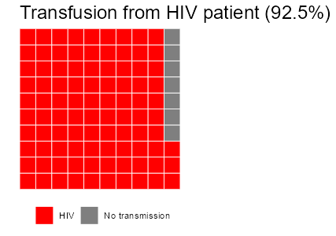
Risk of HIV transmission [1]
Exposure | Risk
Blood transfusion, HIV (+) | 92.5%
Receptive anal intercourse | 1 in 75 (1.4%)
Shared needles (IVDU) | 1 in 160 (0.63%)
Percutaneous (needle stick) | 1 in 450 (0.23%)
Insertive anal intercourse | 1 in 900 (0.11%)
Receptive penile-vaginal intercourse | 1 in 1250 (0.08%)
Insertive penile-vaginal intercourse | 1 in 2500 (0.04%)
Notes:
Source: HIV Nonoccupational Exposure Prophylaxis Clinical Pathway 2021. Johns Hopkins All Children’s Hospital
make_waffle <- function(odds, title="", rows=10){
library(waffle)
waffle(c(HIV=1, `No transmission`=odds-1),
size = .3, legend_pos = "bottom",
rows= rows,
colors = c("red", "grey50"),
title = stringr::str_glue("{title} (1 in {odds})"))
}
# Transfusion
waffle(c(HIV=93, `No transmission`=7),
size = .3, legend_pos = "bottom",
rows= 10,
colors = c("red", "grey50"),
title = "Transfusion from HIV patient (92.5%)")
make_waffle(75, rows=10, title="Receptive anal")
make_waffle(160, rows=10, title="IVDU")
make_waffle(450, title="Needle stick")
make_waffle(900, rows=25, title="Insertive anal")
make_waffle(1250, rows=25, title="Receptive penile-vaginal")
make_waffle(2500, rows=50, title="Insertive penile-vaginal")

Slide 39
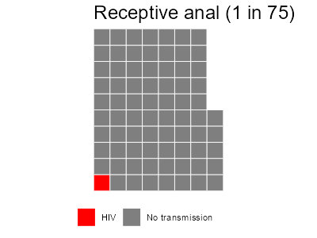
Risk of HIV transmission [1]
Exposure | Risk
Blood transfusion, HIV (+) | 92.5%
Receptive anal intercourse | 1 in 75 (1.4%)
Shared needles (IVDU) | 1 in 160 (0.63%)
Percutaneous (needle stick) | 1 in 450 (0.23%)
Insertive anal intercourse | 1 in 900 (0.11%)
Receptive penile-vaginal intercourse | 1 in 1250 (0.08%)
Insertive penile-vaginal intercourse | 1 in 2500 (0.04%)
Notes:
Source: HIV Nonoccupational Exposure Prophylaxis Clinical Pathway 2021. Johns Hopkins All Children’s Hospital
make_waffle <- function(odds, title="", rows=10){
library(waffle)
waffle(c(HIV=1, `No transmission`=odds-1),
size = .3, legend_pos = "bottom",
rows= rows,
colors = c("red", "grey50"),
title = stringr::str_glue("{title} (1 in {odds})"))
}
# Transfusion
waffle(c(HIV=93, `No transmission`=7),
size = .3, legend_pos = "bottom",
rows= 10,
colors = c("red", "grey50"),
title = "Transfusion from HIV patient (92.5%)")
make_waffle(75, rows=10, title="Receptive anal")
make_waffle(160, rows=10, title="IVDU")
make_waffle(450, title="Needle stick")
make_waffle(900, rows=25, title="Insertive anal")
make_waffle(1250, rows=25, title="Receptive penile-vaginal")
make_waffle(2500, rows=50, title="Insertive penile-vaginal")

Slide 40
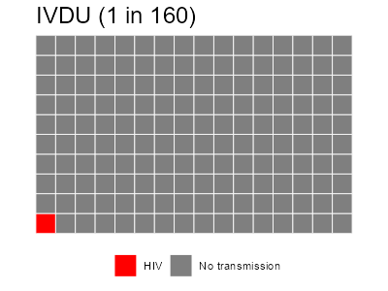
Risk of HIV transmission [1]
Exposure | Risk
Blood transfusion, HIV (+) | 92.5%
Receptive anal intercourse | 1 in 75 (1.4%)
Shared needles (IVDU) | 1 in 160 (0.63%)
Percutaneous (needle stick) | 1 in 450 (0.23%)
Insertive anal intercourse | 1 in 900 (0.11%)
Receptive penile-vaginal intercourse | 1 in 1250 (0.08%)
Insertive penile-vaginal intercourse | 1 in 2500 (0.04%)
Notes:
Source: HIV Nonoccupational Exposure Prophylaxis Clinical Pathway 2021. Johns Hopkins All Children’s Hospital
make_waffle <- function(odds, title="", rows=10){
library(waffle)
waffle(c(HIV=1, `No transmission`=odds-1),
size = .3, legend_pos = "bottom",
rows= rows,
colors = c("red", "grey50"),
title = stringr::str_glue("{title} (1 in {odds})"))
}
# Transfusion
waffle(c(HIV=93, `No transmission`=7),
size = .3, legend_pos = "bottom",
rows= 10,
colors = c("red", "grey50"),
title = "Transfusion from HIV patient (92.5%)")
make_waffle(75, rows=10, title="Receptive anal")
make_waffle(160, rows=10, title="IVDU")
make_waffle(450, title="Needle stick")
make_waffle(900, rows=25, title="Insertive anal")
make_waffle(1250, rows=25, title="Receptive penile-vaginal")
make_waffle(2500, rows=50, title="Insertive penile-vaginal")

Slide 41
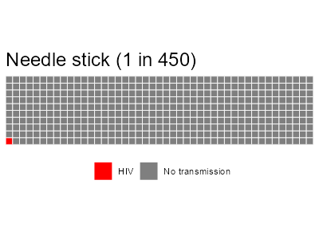
Risk of HIV transmission [1]
Exposure | Risk
Blood transfusion, HIV (+) | 92.5%
Receptive anal intercourse | 1 in 75 (1.4%)
Shared needles (IVDU) | 1 in 160 (0.63%)
Percutaneous (needle stick) | 1 in 450 (0.23%)
Insertive anal intercourse | 1 in 900 (0.11%)
Receptive penile-vaginal intercourse | 1 in 1250 (0.08%)
Insertive penile-vaginal intercourse | 1 in 2500 (0.04%)
Notes:
Source: HIV Nonoccupational Exposure Prophylaxis Clinical Pathway 2021. Johns Hopkins All Children’s Hospital
make_waffle <- function(odds, title="", rows=10){
library(waffle)
waffle(c(HIV=1, `No transmission`=odds-1),
size = .3, legend_pos = "bottom",
rows= rows,
colors = c("red", "grey50"),
title = stringr::str_glue("{title} (1 in {odds})"))
}
# Transfusion
waffle(c(HIV=93, `No transmission`=7),
size = .3, legend_pos = "bottom",
rows= 10,
colors = c("red", "grey50"),
title = "Transfusion from HIV patient (92.5%)")
make_waffle(75, rows=10, title="Receptive anal")
make_waffle(160, rows=10, title="IVDU")
make_waffle(450, title="Needle stick")
make_waffle(900, rows=25, title="Insertive anal")
make_waffle(1250, rows=25, title="Receptive penile-vaginal")
make_waffle(2500, rows=50, title="Insertive penile-vaginal")

Slide 42
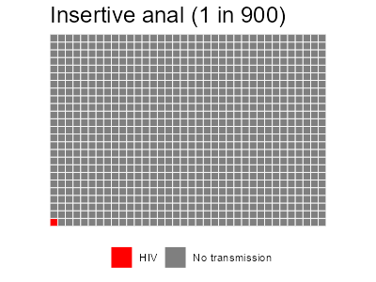
Risk of HIV transmission [1]
Exposure | Risk
Blood transfusion, HIV (+) | 92.5%
Receptive anal intercourse | 1 in 75 (1.4%)
Shared needles (IVDU) | 1 in 160 (0.63%)
Percutaneous (needle stick) | 1 in 450 (0.23%)
Insertive anal intercourse | 1 in 900 (0.11%)
Receptive penile-vaginal intercourse | 1 in 1250 (0.08%)
Insertive penile-vaginal intercourse | 1 in 2500 (0.04%)
Notes:
Source: HIV Nonoccupational Exposure Prophylaxis Clinical Pathway 2021. Johns Hopkins All Children’s Hospital
make_waffle <- function(odds, title="", rows=10){
library(waffle)
waffle(c(HIV=1, `No transmission`=odds-1),
size = .3, legend_pos = "bottom",
rows= rows,
colors = c("red", "grey50"),
title = stringr::str_glue("{title} (1 in {odds})"))
}
# Transfusion
waffle(c(HIV=93, `No transmission`=7),
size = .3, legend_pos = "bottom",
rows= 10,
colors = c("red", "grey50"),
title = "Transfusion from HIV patient (92.5%)")
make_waffle(75, rows=10, title="Receptive anal")
make_waffle(160, rows=10, title="IVDU")
make_waffle(450, title="Needle stick")
make_waffle(900, rows=25, title="Insertive anal")
make_waffle(1250, rows=25, title="Receptive penile-vaginal")
make_waffle(2500, rows=50, title="Insertive penile-vaginal")

Slide 43
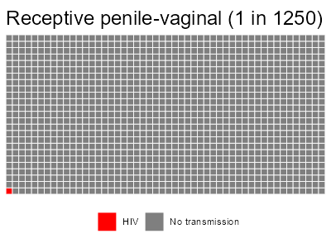
Risk of HIV transmission [1]
Exposure | Risk
Blood transfusion, HIV (+) | 92.5%
Receptive anal intercourse | 1 in 75 (1.4%)
Shared needles (IVDU) | 1 in 160 (0.63%)
Percutaneous (needle stick) | 1 in 450 (0.23%)
Insertive anal intercourse | 1 in 900 (0.11%)
Receptive penile-vaginal intercourse | 1 in 1250 (0.08%)
Insertive penile-vaginal intercourse | 1 in 2500 (0.04%)
Notes:
Source: HIV Nonoccupational Exposure Prophylaxis Clinical Pathway 2021. Johns Hopkins All Children’s Hospital
make_waffle <- function(odds, title="", rows=10){
library(waffle)
waffle(c(HIV=1, `No transmission`=odds-1),
size = .3, legend_pos = "bottom",
rows= rows,
colors = c("red", "grey50"),
title = stringr::str_glue("{title} (1 in {odds})"))
}
# Transfusion
waffle(c(HIV=93, `No transmission`=7),
size = .3, legend_pos = "bottom",
rows= 10,
colors = c("red", "grey50"),
title = "Transfusion from HIV patient (92.5%)")
make_waffle(75, rows=10, title="Receptive anal")
make_waffle(160, rows=10, title="IVDU")
make_waffle(450, title="Needle stick")
make_waffle(900, rows=25, title="Insertive anal")
make_waffle(1250, rows=25, title="Receptive penile-vaginal")
make_waffle(2500, rows=50, title="Insertive penile-vaginal")

Slide 44
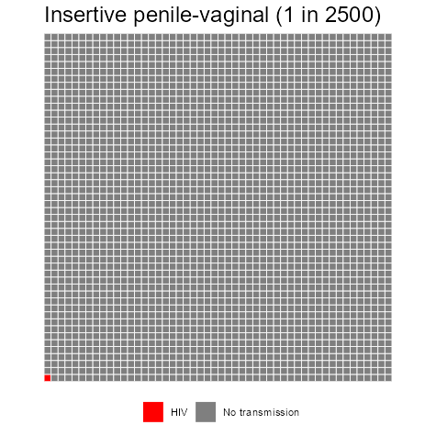
Exposure | Risk
Blood transfusion, HIV (+) | 92.5%
Receptive anal intercourse | 1 in 75 (1.4%)
Shared needles (IVDU) | 1 in 160 (0.63%)
Percutaneous (needle stick) | 1 in 450 (0.23%)
Insertive anal intercourse | 1 in 900 (0.11%)
Receptive penile-vaginal intercourse | 1 in 1250 (0.08%)
Insertive penile-vaginal intercourse | 1 in 2500 (0.04%)
Notes:
Source: HIV Nonoccupational Exposure Prophylaxis Clinical Pathway 2021. Johns Hopkins All Children’s Hospital
make_waffle <- function(odds, title="", rows=10){
library(waffle)
waffle(c(HIV=1, `No transmission`=odds-1),
size = .3, legend_pos = "bottom",
rows= rows,
colors = c("red", "grey50"),
title = stringr::str_glue("{title} (1 in {odds})"))
}
# Transfusion
waffle(c(HIV=93, `No transmission`=7),
size = .3, legend_pos = "bottom",
rows= 10,
colors = c("red", "grey50"),
title = "Transfusion from HIV patient (92.5%)")
make_waffle(75, rows=10, title="Receptive anal")
make_waffle(160, rows=10, title="IVDU")
make_waffle(450, title="Needle stick")
make_waffle(900, rows=25, title="Insertive anal")
make_waffle(1250, rows=25, title="Receptive penile-vaginal")
make_waffle(2500, rows=50, title="Insertive penile-vaginal")

Slide 45
Risk of HIV transmission: if source is on ART
Does the source patient being on ART reduce the likelihood of transmission?
Probably
By how much?
We don’t know

Slide 46
Risk of HIV transmission: if source is on ART
PARTNER study [2]
Robust findings for U=U
But only looked at sexual transmission
The 2020 SHEA guidelines [3]
They appropriately highlight that needlestick is similar to single unprotected sexual encounter in terms of transmission risk
No cases of healthcare workers (HCW) living with HIV transmitting to patients if HCW has VL < 1000
But this is looking at HCW → patient, not patient → HCW transmission

Slide 47
Risk of HIV transmission: if source is on ART
Studies looking at PWID: Some observational studies [4] have implied that ART reduces HIV transmission among PWID
Modeling estimates from Vancouver [5] project that reduced transmission may be more related to reduced drug use among PLHIV who are in treatment
Given the large reduction attributable to reduced drug use, they did not find a large reduction attributable to ART alone

Slide 48
Immediate management of occupational HIV exposures
Describe the risk of HIV transmission in occupational exposures
Review the immediate management of occupational HIV exposures, including:
Suggested labs (from source & exposed)
Timeline of to start PEP
Situations that warrant PEP
Discuss the long-term management of PEP
What agents to pick
Duration of PEP
Follow up testing
Examine key differences of PEP in pregnancy
Risk of transmission
Which agents to use
Risk of breastfeeding
Review the intrapartum management of HIV

Slide 49
Immediate management
Wash the area well
With soap & water
Other agents (alcohol, CHG) are virucidal to HIV
No evidence to support their use
Report it occupational health

Slide 50
Immediate management
Makary et al (NEJM, 2007) [6]
Survey of 700 surgical residents
By the end of residency:
99% had a needlestick
53% had a needlestick from a high risk patient
Mean (PGY-5): 7.7 exposures
Frequently not reported
51% did not report their most recent exposure
16% involved high risk patient
Who do the residents tell?
Most common: attending (51%)
Least: significant other (13%)
Wash the area well
With soap & water
Other agents (alcohol, CHG) are virucidal to HIV
No evidence to support their use
Report it occupational health

Slide 51
Immediate management: Source patient [7][8]
Source patient
Ideally, source patient should be tested
If source is known to be HIV (+), ask about:
Recent viral load
Treatment history
Any resistance
If source has known HIV, do not delay PEP while awaiting this info!
Ideally, started within 1-2 hours of exposure
Cutoff: 72 hours
Exceptionally high risk: USPHS says can be up to a week (but likely very reduced effectiveness)

Slide 52
Immediate management: Exposed patient [8]
Baseline testing
HIV, HCV, anti-HBs, HBsAg
Baseline labs for PEP
Pregnancy testing
Counseling the HCW
Discuss what their risk of acquiring HIV
Many HCW may not know the success of modern HIV treatment, so they will have understandable anxiety about HIV/AIDS
Discuss risk them (exposed) transmitting HIV
Highest risk in first 6-12 weeks
Need for condoms & not donating blood
Watch out for acute retroviral symptoms
Discuss side effects of PEP
One study showed only 60% adherence

Slide 53
When to start PEP? [8]
Source is HIV negative
Unknown HIV status of source
Source is HIV positive
Negative
Test the source
With 4th generation
Positive
No PEP needed
Can stop PEP if already started
Start PEP
(ASAP, within 72h)
Unable to
test souce
No
High risk exposure/source patient?
Yes
Management is different if the source is thought to potentially have acute HIV (beyond the scope of this talk)
Notes:
https://nccc.ucsf.edu/clinical-resources/pep-resources/pep-quick-guide-for-occupational-exposures/

Slide 54
Long-term management of PEP
Describe the risk of HIV transmission in occupational exposures
Review the immediate management of occupational HIV exposures, including:
Suggested labs (from source & exposed)
Timeline of to start PEP
Situations that warrant PEP
Discuss the long-term management of PEP
What agents to pick
Duration of PEP
Follow up testing
Examine key differences of PEP in pregnancy
Risk of transmission
Which agents to use
Risk of breastfeeding
Review the intrapartum management of HIV

Slide 55
Suggested PEP: US Public Health Service [9]
Prefered HIV PEP regimen
Notably, not updated since 2013
This was right around when dolutegravir came to market
TDF/FTC (daily)
Tenofovir / Emtricitabine
+
RAL (BID)
Raltegravir

Slide 56
Suggested PEP: US Public Health Service [9]
Alternate HIV PEP regimens, in order of preference
One of the boxes below
-AND-
One of the boxes below
RAL (raltegravir)
TDF/FTC (Truvada)
Tenofovir / emtricitabine
DRV/r
Darunavir + ritonavir
TDF + 3TC
Tenofovir + lamivudine
Helpful in advanced CKD
ETR (etravirine)
RPV (rilpivirine)
AZT/3TC (Combivir)
Zidovudine/lamivudine
ATV/r
Atazanavir + ritonavir
AZT + FTC
Zidovudine + emtricitabine
LPV/r
Lopinavir + ritonavir

Slide 57
Suggested PEP options: CDC & others [7][8][10]
2 NRTI + integrase inhibitor
TDF/FTC (daily)
Tenofovir / Emtricitabine
+
DTG (daily)
Dolutegravir

Slide 58
Suggested PEP options: CDC & others [7][8][10]
2 NRTI + integrase inhibitor
TDF/FTC (daily)
Tenofovir / Emtricitabine
+
DTG (daily)
Dolutegravir
TDF/FTC (daily)
Tenofovir / Emtricitabine
+
RAL (BID)
Raltegravir
Less ideal due to BID dosing

Slide 59
Suggested PEP options: CDC & others [7][8]
2 NRTI + integrase inhibitor
TDF/FTC (daily)
Tenofovir / Emtricitabine
+
DTG (daily)
Dolutegravir
TDF/FTC (daily)
Tenofovir / Emtricitabine
+
RAL (BID)
Raltegravir
Less ideal due to BID dosing
TAF/FTC (daily)
Tenofovir / Emtricitabine
+
BIC (daily)
Bictegravir
Not listed by CDC [9] (off label)

Slide 60
Suggested PEP options: CDC & others [7][8][10]
2 NRTI + integrase inhibitor
2 NRTI + boosted PI
TDF/FTC (daily)
Tenofovir / Emtricitabine
+
DTG (daily)
Dolutegravir
TDF/FTC (daily)
Tenofovir / Emtricitabine
+
DRV/r (daily)
Ritonavir-boosted darunavir
TDF/FTC (daily)
Tenofovir / Emtricitabine
+
RAL (BID)
Raltegravir
Perhaps more affordable
Less ideal due to BID dosing
TAF/FTC (daily)
Tenofovir / Emtricitabine
+
BIC (daily)
Bictegravir
Not listed by CDC [9] (off label)

Slide 61
Follow up: Duration of PEP & monitoring [8]
Duration of PEP: 28 days from starting
Labs for PEP toxicity
Monitor CBC, renal function, LFTs
Obtain labs at baseline and 2 weeks

Slide 62
Follow up: Duration of PEP & monitoring [8]
Duration of PEP: 28 days from starting
Labs for PEP toxicity
Monitor CBC, renal function, LFTs
Obtain labs at baseline and 2 weeks
Side effects of PEP
Most common: GI (nausea, vomiting, and diarrhea)
Anti-emetics/diarrheals
If severe, can switch to another regimen
Watch out for acute retroviral syndrome

Slide 63
Follow up: HIV testing
For HIV testing:
If source patient is HIV negative, no need for further testing of exposed patient
Unless worried that source had acute HIV
USPHS (2013) [9]: Baseline, 6 weeks, 12 weeks, 6 months
This was before 4th gen screen became widely available
Modern practice [8]: Baseline, 6 weeks, 3-4 months
Extended to 12 months if exposed becomes coinfected with HCV [8][9]

Slide 64
PEP in pregnancy
Describe the risk of HIV transmission in occupational exposures
Review the immediate management of occupational HIV exposures, including:
Suggested labs (from source & exposed)
Timeline of to start PEP
Situations that warrant PEP
Discuss the long-term management of PEP
What agents to pick
Duration of PEP
Follow up testing
Examine key differences of PEP in pregnancy
Risk of transmission
Which agents to use
Risk of breastfeeding
Review the intrapartum management of HIV

Slide 65
Risk of vertical transmission
Transmission rates of HIV (without ART) from mother to child range from 15-45%, including from breastfeeding [11]

Slide 66
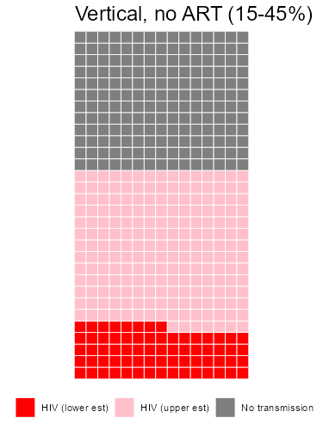
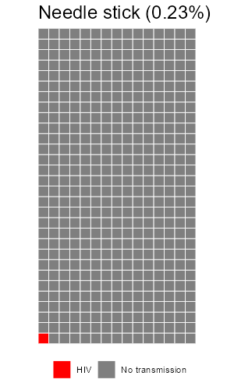
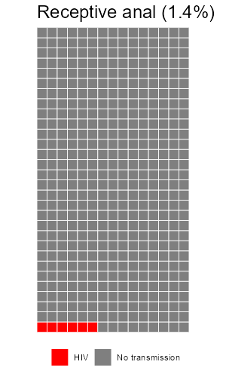
Risk of vertical transmission [11]

Slide 67
Risk of vertical transmission
Transmission rates of HIV (without ART) from mother to child range from 15-45%, including from breastfeeding [11]
Without breastfeeding, it is estimated [12]
30% of vertical transmissions occur in utero, the majority during the 3rd trimester
70% occur during labor & delivery
Taking ART during pregnancy reduces the risk to < 2%
If the mother has acute HIV during pregnancy, this increases the risk by 2.3 [13]

Slide 68
PEP in pregnancy [7][8]
Overall, similar to HIV management in pregnancy (& PEP in non-pregnant patients)
Long term safety data is lacking, most short term data is promising
Enroll patients in the Antiretroviral Pregnancy Registry (www.APRegistry.com)
Notes:
https://clinicalinfo.hiv.gov/en/guidelines/perinatal/safety-toxicity-arv-agents-drug-use-pregnant-overview?view=full

Slide 69
PEP in pregnancy [7][8]
Overall, similar to HIV management in pregnancy (& PEP in non-pregnant patients)
Long term safety data is lacking, most short term data is promising
Enroll patients in the Antiretroviral Pregnancy Registry (www.APRegistry.com)
2 NRTI + integrase inhibitor
TDF/FTC (daily)
Tenofovir / Emtricitabine
+
DTG (daily)
Dolutegravir
Originally thought to ↑ risk of neural tube defects, but later data showed no ↑ risk
TDF/FTC (daily)
Tenofovir / Emtricitabine
+
RAL (BID)
Raltegravir
TAF/FTC (daily)
Tenofovir / Emtricitabine
+
BIC (daily)
Bictegravir
Not enough safety data yet, so not recommended. Though early data is promising

Slide 70
PEP in pregnancy [7][8]
Overall, similar to HIV management in pregnancy (& PEP in non-pregnant patients)
Long term safety data is lacking, most short term data is promising
Enroll patients in the Antiretroviral Pregnancy Registry (www.APRegistry.com)
2 NRTI + integrase inhibitor
2 NRTI + boosted PI
TDF/FTC (daily)
Tenofovir / Emtricitabine
+
DTG (daily)
Dolutegravir
TDF/FTC (daily)
Tenofovir / Emtricitabine
+
DRV/r (daily)
Ritonavir-boosted darunavir
TDF/FTC (daily)
Tenofovir / Emtricitabine
+
RAL (BID)
Raltegravir
Preferred option if needing PI
TAF/FTC (daily)
Tenofovir / Emtricitabine
+
BIC (daily)
Bictegravir

Slide 71
PEP in pregnancy [7][8][9]
2 NRTI backbone
TxF / xTC
Tenofovir / Emtricitabine
Tenofovir / Lamivudine
AZT / 3TC
Zidovudine / Lamivudine
AND
Integrase inhibitor
OR
PI
OR
NNRTI
DTG
Dolutegravir
ATV/r
Atazanavir (boosted)
RPV
Rilpivirine
RAL
Raltegravir
DRV/r
Darunavir (boosted)
Must use ritonavir for boosting, as cobicistat boosted regimens have higher rates of virologic failure
Notes:
This is largely based off of taking what [7] says is safe in pregnancy and cross referencing it with [9] says should be used for PEP
Additional info can be found here https://clinicalinfo.hiv.gov/en/guidelines/perinatal/safety-toxicity-arv-agents-drug-use-pregnant-overview?view=full

Slide 72
Breastfeeding & PEP [8]
Breastfeeding is not a contraindication for PEP
But should discuss infant’s potential risks of HIV transmission & exposure to ART
May consider “pump & dump” or storing breastmilk while awaiting results of source patient’s HIV screen
 | Risk of transmission in breastmilk
HIV | There is risk of transmission; the highest risk is during acute HIV
Tenofovir Lamivudine Dolutegravir | All three have been detected in breastmilk at low levels (subtherapeutic)
Raltegravir | Studies have been mixed

Slide 73
Perinatal HIV management
Describe the risk of HIV transmission in occupational exposures
Review the immediate management of occupational HIV exposures, including:
Suggested labs (from source & exposed)
Timeline of to start PEP
Situations that warrant PEP
Discuss the long-term management of PEP
What agents to pick
Duration of PEP
Follow up testing
Examine key differences of PEP in pregnancy
Risk of transmission
Which agents to use
Risk of breastfeeding
Review the intrapartum management of HIV
Biggest priority
Having mom on ART

Slide 74
Intrapartum HIV: Mode of delivery [14]
Historically, C-sections have been associated with lower risk of mother to child transmission
Largely based off of data before widespread use of ART in pregnancy was common
Now, mode of delivery is largely informed by maternal viral load (ideally within 4 weeks of delivery)
Below 1000
Delivery per obstetric indications
Maternal HIV VL (within 4 weeks of delivery)
Above 1000
(or not on ART)
C-section at
38 weeks

Slide 75
Intrapartum HIV: ART [14]
Women should keep taking their ART before/during/after delivery
Indications for IV zidovudine (ideally started 3 hours before delivery)
VL below 50: No benefit
50 - 1000: consider AZT
>1000: AZT (along with C-section)
Below 50
No zidovudine needed
Maternal HIV VL (within 4 weeks of delivery)
Above 50
(or not on ART)
Intrapartum IV AZT

Slide 76
Learning points & take aways

Slide 77
Learning points & take aways
Risk to HIV transmission from occupation needle sticks are around 1 in 450, but likely lower if the source patient is on ART
In the event of a needle stick, wash the area with soap & water and immediately report to occupational health or the ED to start PEP (ideally within 1-2 hours)
Ideally, obtain data on the source patient including HIV, HCV, and HBV status
For sources known to be HIV positive, recent viral load & treatment history is helpful
HIV PEP is indicated when the source has HIV (or high risk source patient)
Suggested PEP: 28 days of TxF/xTC -plus- INSTI (DTG, RAL, ?BIC) or booster PI (DRV/r)
Monitor for toxicity (labs at baseline, 2 weeks) and side effects
Exposed patient should have HIV screen at baseline, 6 weeks, and 3-4 months (unless HCV+)
PEP is similar in pregnancy (but perhaps more important given risk of transmission with acute HIV)
At time of delivery, C-section & intrapartum AZT if VL is above 1000 &/or 50 (respectively)
Slides available on hunterratliff1.com/talk/; Citations available via QR code or via the “citations” button on the website

