Slide 1
Chicken & Fish
CID conference
Hunter Ratliff
09/05/2024
Ages, dates, and other less-relevant (and identifying) information may have been changed

Slide 2
Case #1

Slide 3
Case 1: HPI
A 58 y/o M with PMH including central serous retinopathy, Afib, T2DM, HTN, HLD, OSA, CKD, hypothyroidism, hypogonadism p/w multiple abscesses

Slide 4
Case 1: HPI
A 58 y/o M with PMH including central serous retinopathy, Afib, T2DM, HTN, HLD, OSA, CKD, hypothyroidism, hypogonadism p/w multiple abscesses
One month ago, had a large, heavy chicken coup fall across him
Fell on top of his right chest to left thigh
Unclear if puncture wound, but coop was covered in chicken wire
A few days later, developed SQ abscesses at site of injury
Rx: Keflex & doxy but no improvement in symptoms
Seen in surgery clinic where he was lethargic, mildly confused, and ill-appearing
Sent to ED and found to have sepsis

Slide 5
Case 1: Past medical history
A 58 y/o M with PMH including central serous retinopathy, Afib, T2DM, HTN, HLD, OSA, CKD, hypothyroidism, hypogonadism p/w multiple abscesses
Central serous retinopathy: Follows with Cleveland clinic, has been on high dose steroids, up to prednisone 60 mg / day, tapering recently
Hx of cellulitis: Treated with IV antibiotics two years ago, unclear history
Numerous dental issues in the past as well as recurrent sinus infections
Hx of a few surgeries (multiple spine surgeries, TKR) w/ hardware

Slide 6
Case 1: Social History, Exposures, Risk Factors
Geographic & Occupational: The patient lives in West Virginia. He denies recent foreign or domestic travel. They are retired, used to sell pharma
Substance: They deny alcohol use and he does not use tobacco . They report no recreational drug use
Sexual History: Sexual activity with only women. Denied using any condoms or barriers. Denied ever testing positive for STIs
Environmental exposures: Denies freshwater exposure. Though he cannot recall if the coop caused a puncture wound, he thinks if it did cause puncture injury there would have been soil exposure
Animal Exposures: Cats, dogs, chickens
Tattoos & Piercing: They have previously gotten tattoos (professionally done)

Slide 7
Case 1: Initial exam
Hypotensive requiring low dose levophed
Gen: alert and oriented, NAD, vitals reviewed
Head/Neck: NCAT; trachea appears midline, no gross LAD
ENT: EOMI grossly, anicteric sclerae; MMM
Resp: normal respiratory effort, symmetric chest rise
CV: RRR; extremities perfused
GI: non-distended; no rebound or guarding
Extremities: 3+ BLE edema, + redness LLE, no tenderness in the calves or thighs, no varicosities
Neurologic: gait is normal, DTR intact bilaterally. Alert and oriented x3. Drowsy on exam.

Slide 8
Case 1: Initial workup
WBC: 21 (90% NΦ)
ESR 27; CRP 8.6
Cr: 1.9
Lactate: 4
A1c: 9.7
CT C/A/P
Multiple probable subcutaneous abscesses overlying (up to 5.7cm) the right anterolateral upper abdominal soft tissues, with overlying cellulitis.
No extension into the peritoneum evident.
CT LLE
16.2 cm subcutaneous abscess in the soft tissues of the medial left mid to distal thigh with invasion of adjacent musculature

Slide 9
Case 1: Summary
Exam
Hypotensive, BLE swelling, ?confused
Labs
WBC 21, lactate 4, A1c 9.7
A 58 y/o M with PMH including central serous retinopathy (on steroids), Afib, T2DM, HTN, HLD, OSA, CKD p/w multiple abscesses one month after chicken coop fell on him.
Rx: Keflex & doxy but no improvement in symptoms
Unclear if puncture injury
Recurrent sinusitis & dental issues
CT C/A/P
Multiple probable subcutaneous abscesses overlying (up to 5.7cm) the right anterolateral upper abdominal soft tissues, with overlying cellulitis
CT LLE
16.2 cm subcutaneous abscess in the soft tissues of the medial left mid to distal thigh with invasion of adjacent musculature

Slide 10
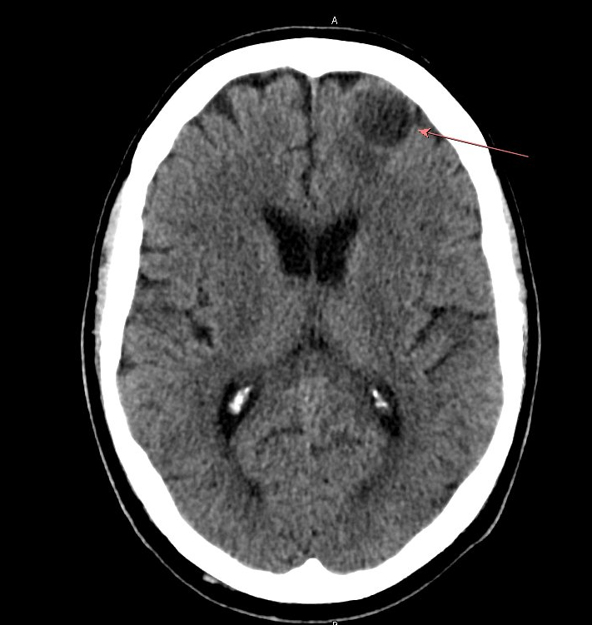
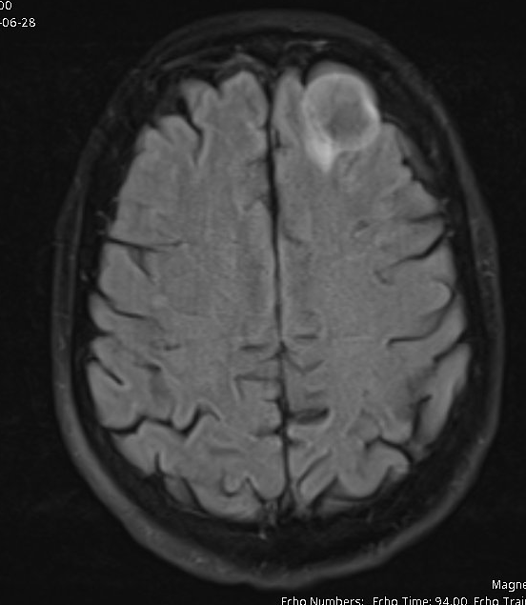
Case 1: Summary
Exam
Hypotensive, BLE swelling, ?confused
Labs
WBC 21, lactate 4, A1c 9.7
CT Head
2.3 cm rounded hypodense mass lesion within or adjacent to the left anterior frontal lobe possibly representing a cystic neoplasm or even abscess in the appropriate setting
A 58 y/o M with PMH including central serous retinopathy (on steroids), Afib, T2DM, HTN, HLD, OSA, CKD p/w multiple abscesses one month after chicken coop fell on him.
Rx: Keflex & doxy but no improvement in symptoms
Unclear if puncture injury
Recurrent sinusitis & dental issues
MRI Brain
3 cm rim enhancing cerebral abscess within the left anterior frontal lobe with adjacent rim of edema.

Slide 11
Case 1: Hospital Course
Taken from ED by surgery for emergent I&D of left leg & abdominal wall abscesses
Operative cultures
Abdomen: Raoultella planticola
Leg: No growth at time of chart review
Admitted to MICU for shock, transferred to Ruby for NSGY evaluation
ID consulted (on my first day of fellowship)

Slide 12
Case 1: Hospital Course
Taken from ED by surgery for emergent I&D of left leg & abdominal wall abscesses
Operative cultures
Abdomen: Raoultella planticola
Leg: No growth at time of chart review
Admitted to MICU for shock, transferred to Ruby for NSGY evaluation
ID consulted (on my first day of fellowship)

Slide 13
Case 1: Hospital Course
Operative cultures
Abdomen: Raoultella planticola, S epi
Leg: Nocardia farcinica
Brain: Nocardia, S epi
s/p multiple abdominal & leg washouts
NSGY I&D of brain abscess

Slide 14
Case 1: Hospital Course
Micro data
Abdomen: Raoultella planticola, S epi
Leg: Nocardia farcinica
Brain: Nocardia, S epi
Uncomplicated first admission
Discharged on
Bactrim + Zyvox (CNS: Nocardia + MRSE)
Augmentin (SQ: Raoultella)
Antimicrobial course
Bactrim / Imi / Linezolid (empiric)
Discharge:
Bactrim + Zyvox (Nocardia + MRSE)
Augmentin (Raoultella)

Slide 15
Case 1: Readmission
Micro data
Abdomen: Raoultella planticola, S epi
Leg: Nocardia farcinica
Brain: Nocardia, S epi
Readmitted for unrelated reasons, but family wanted IV treatment
Susceptibilities returned. Discharged on
CNS nocardia: Moxi + Bactrim
CNS MRSE: Vanco (DOT: 4 weeks) d/t TCP
At discharge, had finished 2 weeks of Raoultella coverage for SQ infection
Nocardia susceptibilities
Tobramycin 32 Resist
Linezolid 4 Suscept
Bactrim 2/38 Suscept
Doxycycline 8 Resist
Ciprofloxacin 0.5 Suscept
Amoxicillin/Clavulanate 8/4 Suscept
Moxifloxacin 0.25 Suscept
Amikacin 1 Suscept
Imipenem 32 Resist
Ceftriaxone >=128 Resist
Clarithromycin >=32 Resist
Minocycline 4 Intermed
Antimicrobial courses
Bactrim / Imi / Linezolid (empiric)
Discharge #1:
Bactrim + Zyvox (Nocardia + MRSE)
Augmentin (Raoultella)
Discharge #2:
CNS nocardia: Moxi + Bactrim
CNS MRSE: Vanco (DOT: 4 weeks)

Slide 16
Case 1: Clinic #1
Micro data
Abdomen: Raoultella planticola, S epi
Leg: Nocardia farcinica
Brain: Nocardia, S epi
During OPAT, developed AKI so vanco stopped a little early (but likely still had ~4 weeks)
Having GI intolerance (maybe to Bactrim?)
Kept on Moxi & Bactrim until 6 weeks
Nocardia susceptibilities
Tobramycin 32 Resist
Linezolid 4 Suscept
Bactrim 2/38 Suscept
Doxycycline 8 Resist
Ciprofloxacin 0.5 Suscept
Amoxicillin/Clavulanate 8/4 Suscept
Moxifloxacin 0.25 Suscept
Amikacin 1 Suscept
Imipenem 32 Resist
Ceftriaxone >=128 Resist
Clarithromycin >=32 Resist
Minocycline 4 Intermed
Antimicrobial courses
Bactrim / Imi / Linezolid (empiric)
Discharge #1:
Bactrim + Zyvox (Nocardia + MRSE)
s/p 2 weeks Augmentin (Raoultella)
Discharge #2:
CNS nocardia: Moxi + Bactrim
s/p 4 weeks Vanco
Clinic #1:
CNS nocardia: Moxi + Bactrim

Slide 17
Case 1: Clinic #2
Antimicrobial courses
Bactrim / Imi / Linezolid (empiric)
Discharge #1:
Bactrim + Zyvox (Nocardia + MRSE)
s/p 2 weeks Augmentin (Raoultella)
Discharge #2:
CNS nocardia: Moxi + Bactrim
s/p 4 weeks Vanco
Clinic #1:
CNS nocardia: Moxi + Bactrim
OPAT: Had to stop bactrim 2/2 AKI
Clinic #2:
c/w Moxi
Added Augmentin
During OPAT, developed AKI (again) so Bactrim stopped at 6 weeks. GI symptoms resolved
Added Augmentin for SQ disease
Nocardia susceptibilities
Tobramycin 32 Resist
Linezolid 4 Suscept
Bactrim 2/38 Suscept
Doxycycline 8 Resist
Ciprofloxacin 0.5 Suscept
Amoxicillin/Clavulanate 8/4 Suscept
Moxifloxacin 0.25 Suscept
Amikacin 1 Suscept
Imipenem 32 Resist
Ceftriaxone >=128 Resist
Clarithromycin >=32 Resist
Minocycline 4 Intermed

Slide 18
Case 1 discussion
Links to articles discussed here

Slide 19
Nocardia
Objectives
Review microbiology & risk factors
Describe clinical syndromes
Review treatment options
Articles

Slide 20
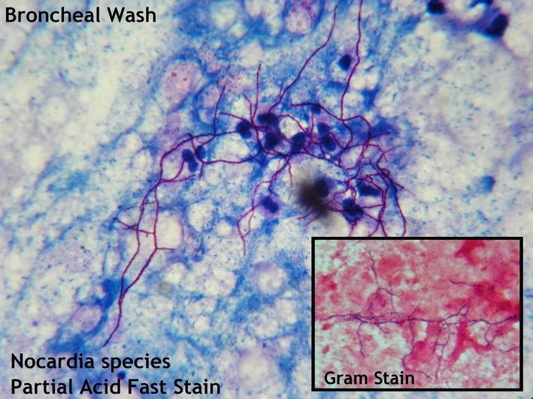
Nocardia: Microbiology
Delicate filamentous gram-positive branching rods
Weakly acid fast
Aerobic growth
Numerous species
Species can be helpful in predicting susceptibilities (Toyokawa 2021)

Slide 21
Nocardia: Antimicrobial susceptibilities
 | N. farcinica | N. nova | N. brasiliensis | N. cyriacigeorgica | N. abscessus | N. otitidiscaviarum
Bactrim | S | S | S | S | S | S
Imipenem | S | S | R | S | S | R
Amikacin | S | S | S | S | S | S
Linezolid | S | S | S | S | S | S
Tobramycin | R | R | S | S | S | S
Augmentin | S | R | S | R | S | R
Ceftriaxone | R | S | R | S | S | R
Ciprofloxacin | R | R | R | R | R | R
Clarithromycin | R | S | R | R | R | R
Doxycycline | R | R | R | R | S | R
Minocycline | R | R | R | R | S | R
Erythromycin | R | S | R | R | R | R
Adapted from UpToDate

Slide 22
Nocardia: Risk factors
Natural reservoir is soil & decaying vegetation
Transmission via inhalation or direct inoculation
Immunosuppression is major risk factor (though can occur in immunocompetent)
Steroids are most frequently reported risk factor
Solid organ transplant

Slide 23
Nocardia: Clinical Syndromes
Subacute infection
Main sites of infections
Lungs
Skin
CNS
Hematogenous spread is common in disseminated disease

Slide 24
Nocardia: Clinical Syndromes
Subacute infection
Main sites of infections
Lungs
Skin
CNS
Hematogenous spread is common in disseminated disease
Pulmonary disease
Most common site of disease
Variable presentation:
Pneumonia
Lung abscess
Cavitary lesion
Empyema
More likely to go to CNS (vs skin)
Can mimic flares of chronic lung disease (e.g. sarcoid patient who is on steroids)

Slide 25
Nocardia: Clinical Syndromes
Subacute infection
Main sites of infections
Lungs
Skin
CNS
Hematogenous spread is common in disseminated disease
Skin / soft tissue
Often in setting of trauma
Primary skin infection is most common in immunocompetent
Types
Localized: Cellulitis or SQ abscess +/- drainage
Lymphocutaneous: Nodular lymphangitis "sporotrichoid nocardiosis"
If thinking sporotrichosis (e.g. thorn injury) consider nocardia
Mycetoma: chronic cutaneous infection that coalesces to large necrotic abscess with draining sinus tracts

Slide 26
Nocardia: Clinical Syndromes
Subacute infection
Main sites of infections
Lungs
Skin
CNS
Hematogenous spread is common in disseminated disease
CNS disease
Nocardia loves to go to the brain
One or more abscesses
May or may not be symptomatic
If someone has nocardia, you should scan their head!

Slide 27
Nocardia: Initial treatment
Bactrim is the mainstay treatment
Resistance can occur, so send for susceptibilities
Initial therapy often Bactrim + something else
Often imipenem or amikacin
If CNS, some use all three
Disseminated disease (including CNS) induction therapy:
At least six weeks of double coverage
Frequently IV

Slide 28
Nocardia: Long term treatment
Always guided by susceptibilities and clinical response
High risk of relapse / treatment failure
PO stepdown: After 3-6 weeks and clinical response:
Non-CNS: After 3 weeks, consider PO monotherapy
CNS &/or immunocompromised: After 6 weeks, consider switch to PO combo therapy
Duration of therapy
Not well defined
Isolated cutaneous: 3-6 months (immunocompetent), 6-12 months (immunocompromised)
CNS or immunocompromised: At least one year
Secondary prophylaxis:
May be some role for Bactrim PPx (1 DS daily) if immunosuppressed and no expected recovery (e.g. BMT, SOT)

Slide 30
Case #2

Slide 31
Case 2: HPI
A 25 y/o M with PMH of bipolar (on Lamictal) is referred to ID clinic for a positive PPD
Feels well, ROS entirely negative
No known exposure to TB
Prior TB testing (both TST & IGRA) have all been negative

Slide 32
Case 2: Social History, Exposures, Risk Factors
Geographic: He has never traveled abroad (all of his military work was stateside). During his time in the military, was stationed in Louisiana for most of the time, but also a few months in North Carolina. When he left the military two years ago, he moved from Louisiana to WV and hasn’t traveled out of WV since
Occupational / Hobbies: Joined Army six years ago. Primarily worked in healthcare (his base’s clinic) doing mostly administrative work. Would provide limited patient care when needed (e.g. triage) and only off-base work was during EMT training. While in Louisiana, he went out to the bayous to fish. Still enjoys fishing in WV, but not as good crayfishing up here. Now working in athletics department here, which prompted TB testing.

Slide 33
Case 2: Social History, Exposures, Risk Factors
Infectious PMH: No history of BCG vaccine. No known household contacts with TB or who are immunocompromised. Aside from what was mentioned in occupational section, no other worrisome possible exposures to TB (incarceration exposure, homeless shelters)
Animal Exposures: Has pets (cats and fish). Otherwise denies farm animal exposures, bird/reptile exposures, or other animal exposure.
Substance: They only drink socially and he does not use tobacco. They report no recreational drug use
Sexual History: They are are sexually active with only their female partner (of many years). The patient reports consistent condom use. No history of STIs
Tattoos & Piercing: They have previously gotten tattoos (professionally done) and no piercings .

Slide 34
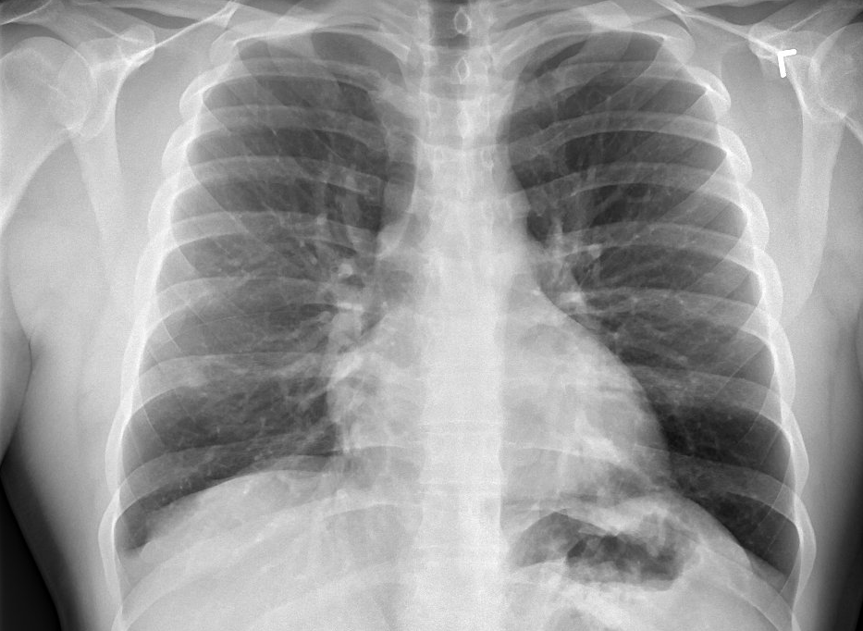
Case 2: TB testing history
Date | PPD induration
-3mo | 0mm
-3mo + 9 days | 12mm
1 week ago | 15mm
Initial TST when he joined the military was negative
While in the military, had TB testing (both TST and IGRA) every six months that were all negative
Was not told that any of his clinic patients were positive for TB
He had testing at the end of his time in the service which was negative
Had two step PPD for pre-employment screen

Slide 35
Case 2: Summary
Date | PPD induration
-3mo | 0mm
-3mo + 9 days | 12mm
1 week ago | 15mm
A 25 y/o M with PMH of bipolar (on Lamictal) is referred to ID clinic for a positive PPD
Pre-military: TST negative
q6mo: all negative
End of service: negative

Slide 36
Case 2: Conclusion
Date | PPD induration
-3mo | 0mm
-3mo + 9 days | 12mm
1 week ago | 15mm
A 25 y/o M with PMH of bipolar (on Lamictal) is referred to ID clinic for a positive PPD
Pre-military: TST negative
q6mo: all negative
End of service: negative
HIV screen negative
QuantGold negative
Treated PPD as false positive
Possibly from NTM exposure given fishing history & time in Louisiana

Slide 37
Case 2 discussion
Links to articles discussed here

Slide 38
NTM infections & Mtb testing
Objectives
Review the classification of mycobacteria
Review features of NTM
Transmission & exposures
Clinical syndromes
Describe geographic distribution of NTM infections in US
Discuss LTBI screening guidelines
Focus on distinguishing NTM from Mtb
Articles
NTM = nontuberculous mycobacterial
Mtb = Mycobacterium tuberculosis

Slide 39
Types of mycobacteria
Mycobacterium tuberculosis complex
M. tuberculosis
M. bovis
M. africanum
M. microti
M. canetti
M. leprae
Rapidly growing NTM
Slow growing NTM

Slide 40
Types of mycobacteria
Slowly growing NTM
Photochromogens
M. kansasii
M. marinum
Scotochromogens
M. gordonae
M. scrofulaceum
Nonchromogens
M. avium complex
M. avium
M. intracellulare
M. chimaera
M. terrae complex
M. ulcerans
M. xenopi
M. simiae
M. malmoense
M. szulgai
M. asiaticum
M. haemophilum
Mycobacterium tuberculosis complex
M. leprae
Rapidly growing NTM
M. fortuitum complex
M. fortuitum
M. peregrinum
M. porcinum
M. chelonae
M. abscessus complex
M. smegmatis
M. mucogenicum

Slide 42
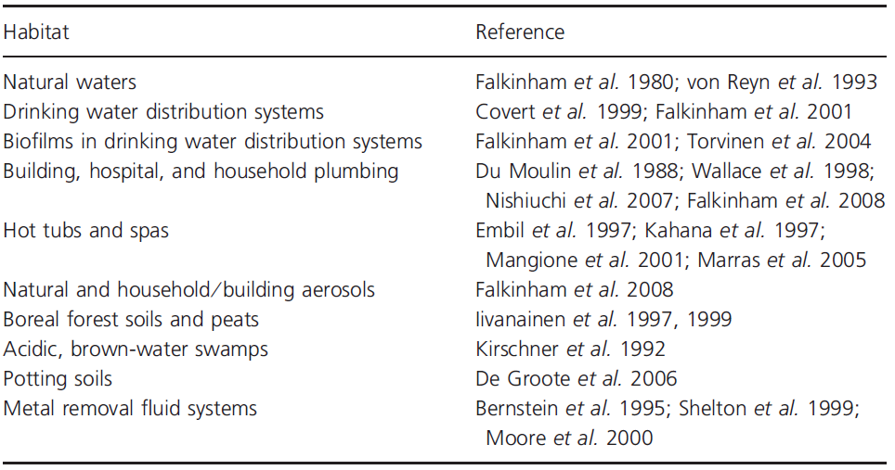
Where does NTM live?
Table 2: Habitats of environmental opportunistic mycobacteria
Falkinham 2009

Slide 43
Mycobacterium avium complex
Exposures:
Soil
Water (aerosolized from showerheads; hot tubs, natural surface water)
Animals
Higher rates near gulf coast
Disease:
Lung disease
Disseminated in immunocompromised
Slow growers
M. avium complex
M. kansasii
M. marinum
M. ulcerans
M. xenopi
M. simiae
M. malmoense
Rapid growers
M. abscessus complex
M. fortuitum complex
M. chelonae
M. abscessus subspecies massiliense
M. abscessus subspecies bolletii

Slide 44
Mycobacterium kansasii
Exposures:
Also high predisposition for south coast & central plains
Not found in soil or natural water supply
Has been found in city water supply
Disease:
Can cause lung disease like MTB
Similar to MAC, mostly occurs in those with existing lung disease or immunocompromised
Slow growers
M. avium complex
M. kansasii
M. marinum
M. ulcerans
M. xenopi
M. simiae
M. malmoense
Rapid growers
M. abscessus complex
M. fortuitum complex
M. chelonae
M. abscessus subspecies massiliense
M. abscessus subspecies bolletii

Slide 45
Mycobacterium abscessus complex
Exposures:
Similar environmental exposures (soil, water, animals)
Hospital tap water
Breast implant outbreak
Disease:
Lung disease (even in immunocompetent)
SSTI
Disseminated in immunocompromised
Slow growers
M. avium complex
M. kansasii
M. marinum
M. ulcerans
M. xenopi
M. simiae
M. malmoense
Rapid growers
M. abscessus complex
M. fortuitum complex
M. chelonae
M. abscessus subspecies massiliense
M. abscessus subspecies bolletii

Slide 46
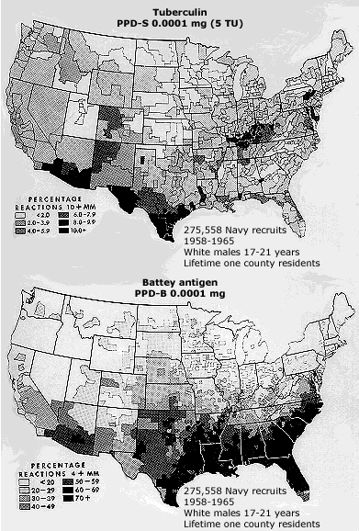
NTM Geography
Very old study of 275,000 Navy recruits (1969)
I can’t access the article but sounds like they all lived their entire lives in one county
Over 70% of those in southeastern or gulf coast states had been exposed or infected with MAC
Geographic variation in the frequency of reactors to PPD-S (top) and to PPD-B 9 (bottom).
Edwards, et al, Am Rev Respir Dis 1969; 99(Suppl):1.
Notes:
Figure 1 of UpToDate article “Epidemiology of NTM infections” (accessed 9/1/24) - unable to access actual article

Slide 47
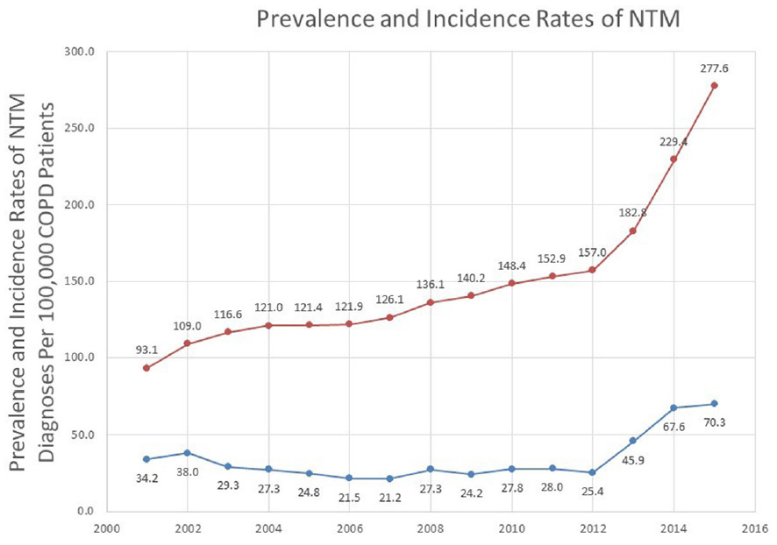
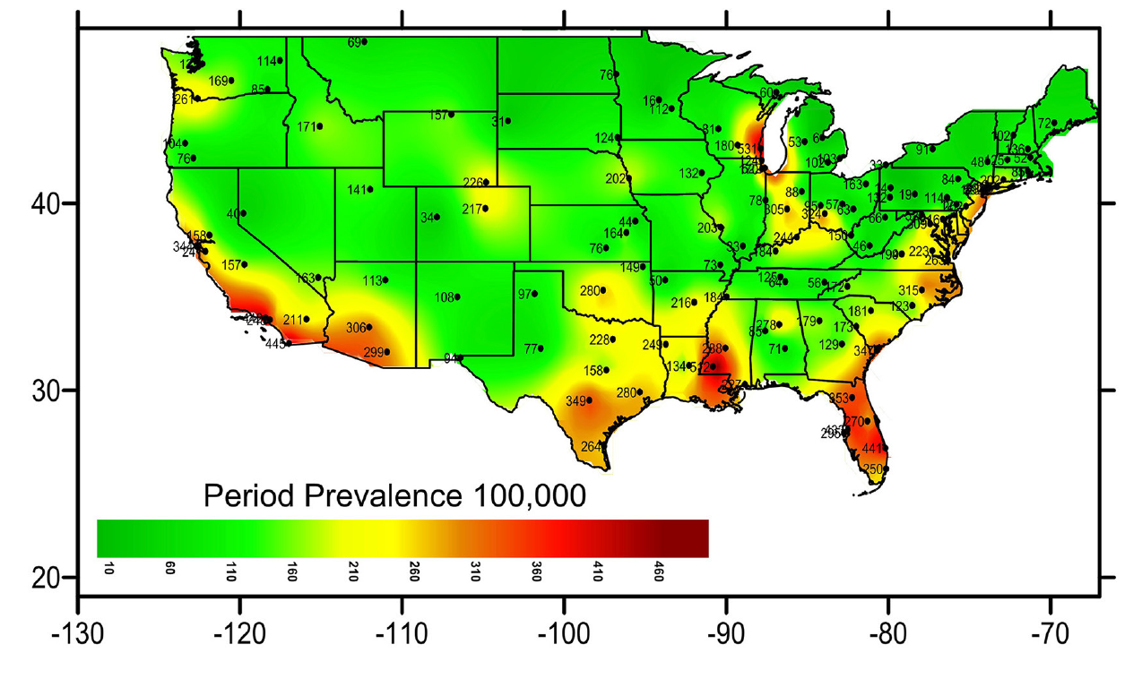
NTM Geography
VA administrative data (2001 - 2015)
Only looked at COPD patients
Rising incidence in 2012
Left: Period prevalence of NTM infections (figure 1)
Above: Prevalence & incidence (figure 2)
Pyarali et al (2018)

Slide 48
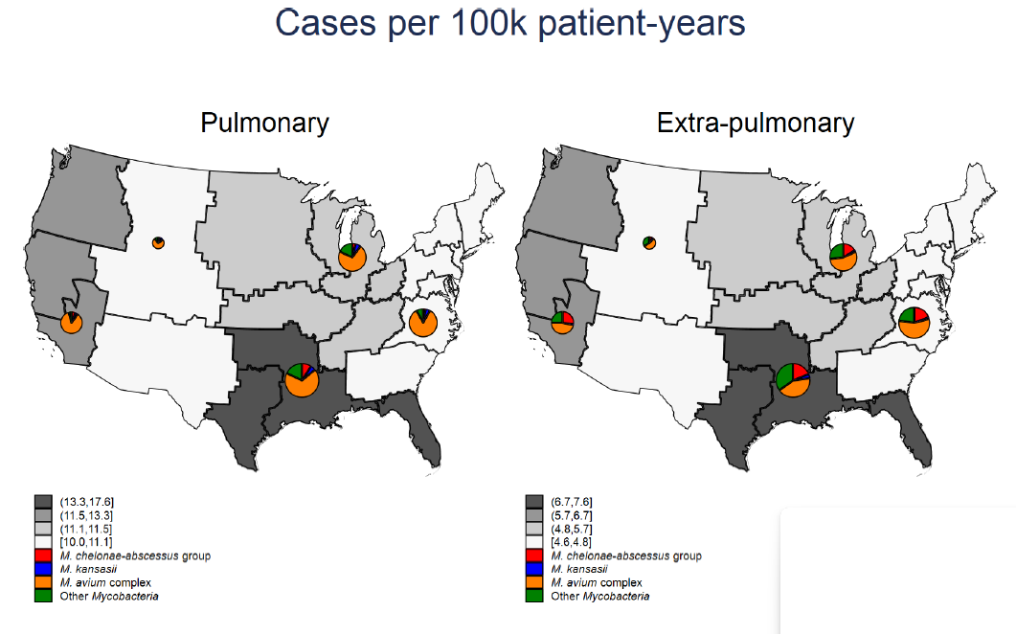
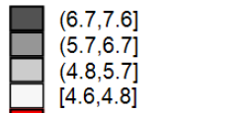
NTM Geography
Also VA patients (2009 - 2012)
Not restricted to COPD patients
Identified cases by ICD code and natural language processing of micro data
Incident rates of NTM infections in VA patients (2009-2012)
Jones et al (2018), Figure 1

Slide 49
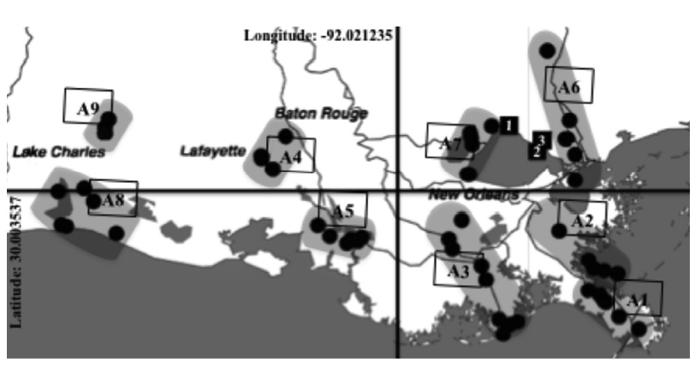
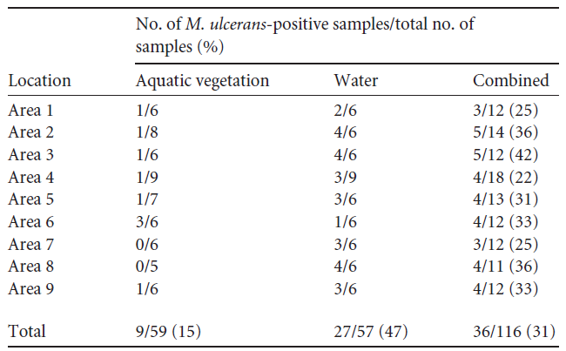
NTM Geography
Military base
Environmental study out of LSU & Tulane (summer of 2011)
PCR for M. ulcerans
So far no human cases in US from M ulcerans
Samples collected from 9 sites
High rates (47%) found in water samples
Similar rates for fresh / brackish / salt water
Top: Sampling sites in Louisiana study of M. ulcerans (Figure 1)
Bottom: Sample PCR positivity for M. ulcerans, by type & source (Table 3)
Hennigan (2013)

Slide 50
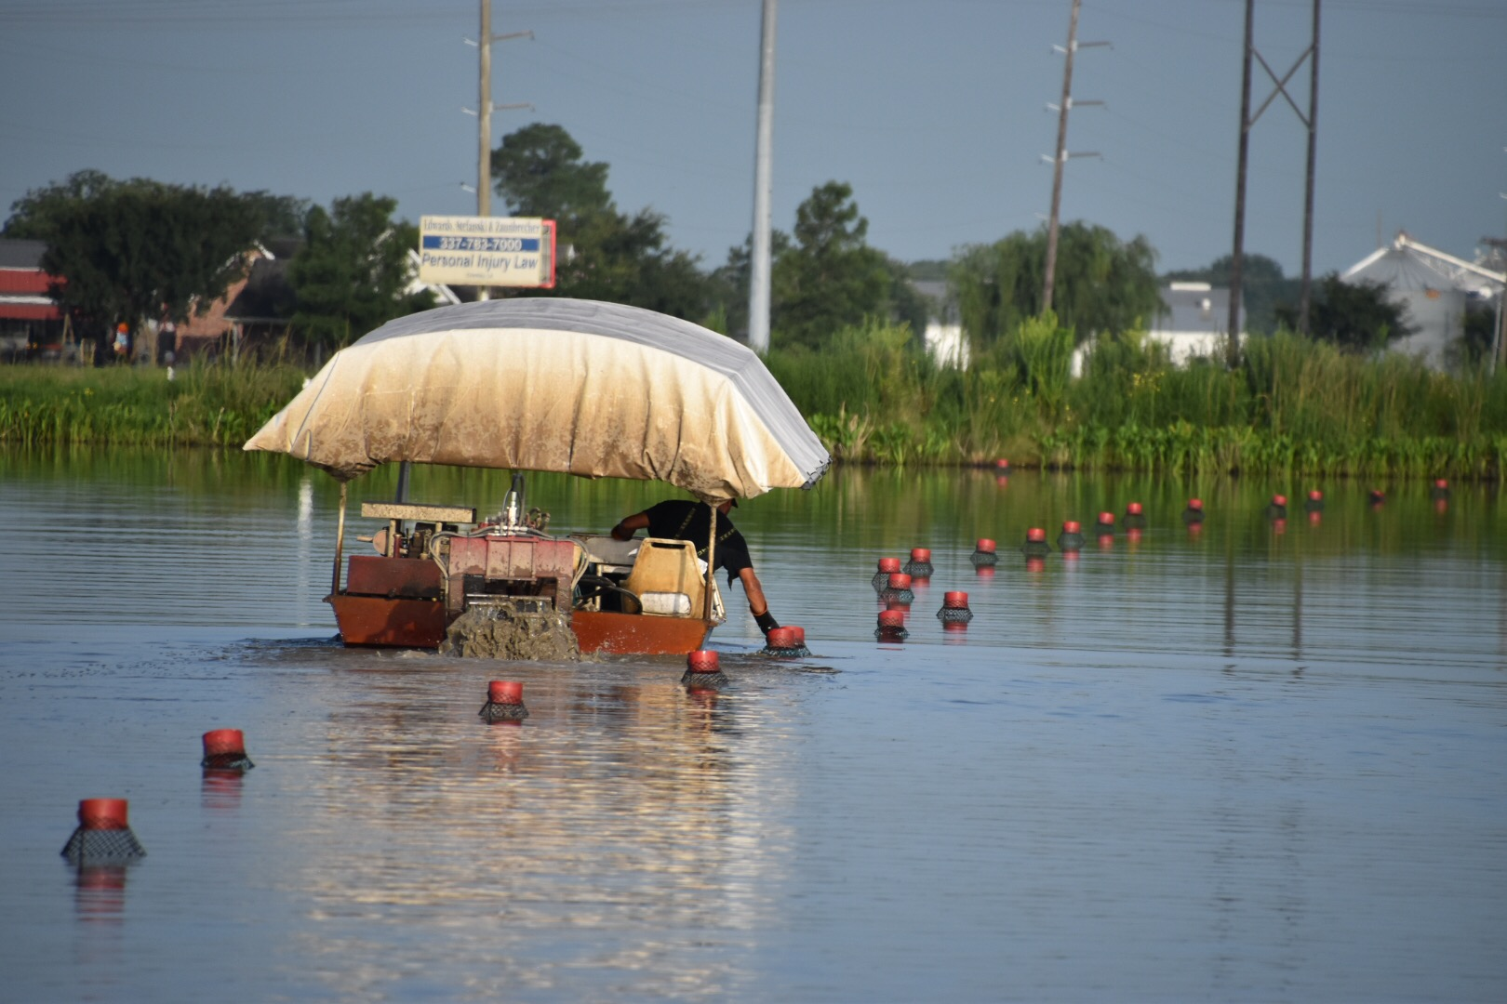
But back to the Cajun food

Slide 51
Mycobacterium marinum
Infection is less common
Found in water (fresh & salt): marine environment, swimming pools, and fish tanks
Fish tank granuloma: Sink infection from contaminated fish tank, often when preexisting skin injury
Slow growers
M. avium complex
M. kansasii
M. marinum
M. ulcerans
M. xenopi
M. simiae
M. malmoense
Rapid growers
M. abscessus complex
M. fortuitum complex
M. chelonae
M. abscessus subspecies massiliense
M. abscessus subspecies bolletii

Slide 52
Mycobacterium marinum
Infection is less common
Found in water (fresh & salt): marine environment, swimming pools, and fish tanks
Fish tank granuloma: Sink infection from contaminated fish tank, often when preexisting skin injury
Can cause false positive TST test
Case series of patients (n=7) who had SSTI infection with M marinum (Lewis 2003)
100% had PPD > 10mm
29% had PPD > 15mm
Four patients had negative PPD documented before infection
Slow growers
M. avium complex
M. kansasii
M. marinum
M. ulcerans
M. xenopi
M. simiae
M. malmoense
Rapid growers
M. abscessus complex
M. fortuitum complex
M. chelonae
M. abscessus subspecies massiliense
M. abscessus subspecies bolletii

Slide 53
Mycobacterium marinum
Infection is less common
Found in water (fresh & salt): marine environment, swimming pools, and fish tanks
Fish tank granuloma: Sink infection from contaminated fish tank, often when preexisting skin injury
Can cause false positive TST test (Lewis 2003)
Case series of NTM SSTI (n=78) from UTMB, which is on the gulf coast (Philips 2019)
M. abscessus (47%)
M. fortuitum (26%)
M. marinum (21%)
Slow growers
M. avium complex
M. kansasii
M. marinum
M. ulcerans
M. xenopi
M. simiae
M. malmoense
Rapid growers
M. abscessus complex
M. fortuitum complex
M. chelonae
M. abscessus subspecies massiliense
M. abscessus subspecies bolletii

Slide 54
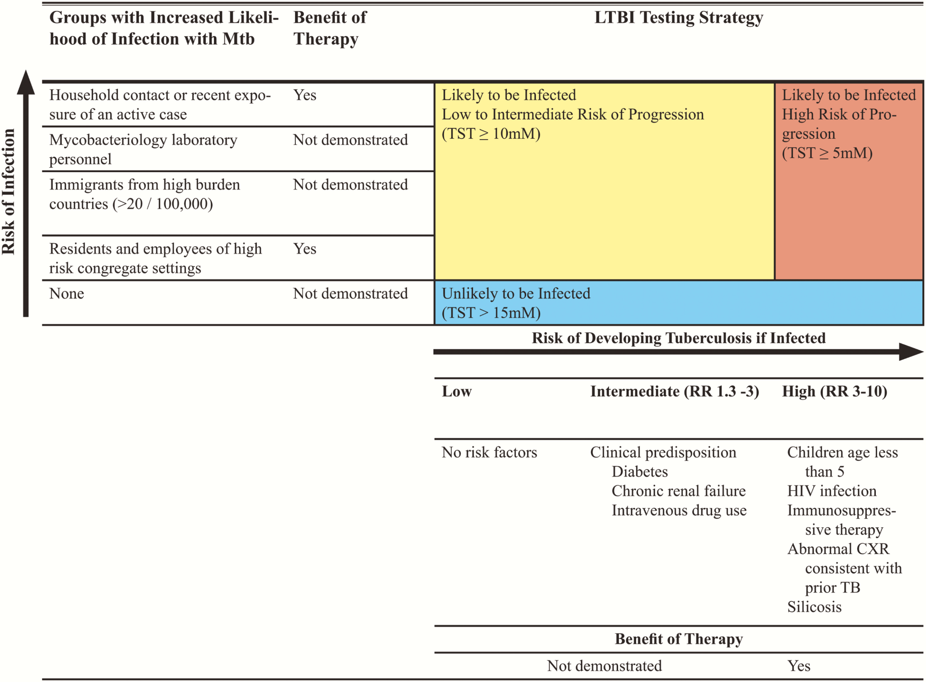
IDSA: LTBI screening
Persons at low risk for Mtb infection and disease progression NOT be tested for Mtb infection
LTBI = latent tuberculosis infection
Mtb = Mycobacterium tuberculosis
Paradigm for evaluation of those with LTBI based on risk of infection, risk of progression to tuberculosis, and benefit of therapy. (figure 1, 2017 IDSA guidelines)

Slide 55
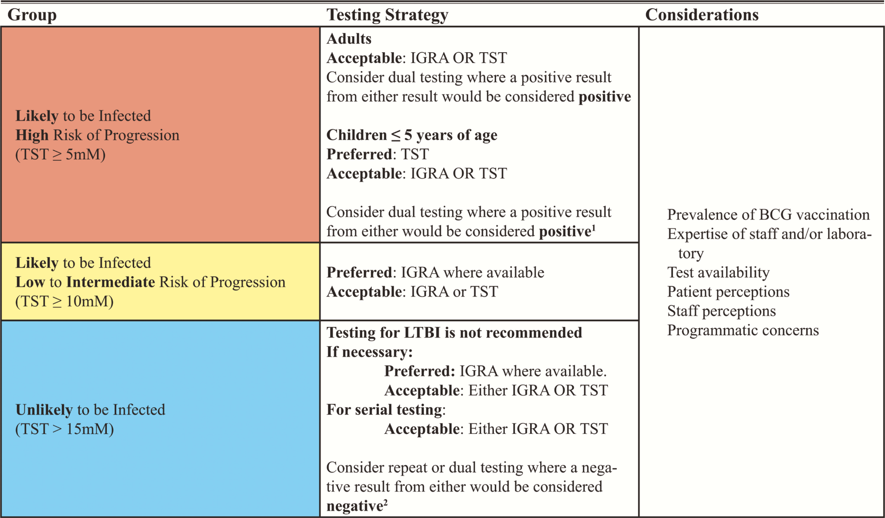
IDSA: LTBI screening
Persons at low risk for Mtb infection and disease progression NOT be tested for Mtb infection
If you have to test them
Favor IGRA over TST (if >5 y.o.)
If initial test is positive, suggest a second diagnostic test
Summary of recommendations for testing for LTBI
(figure 2, 2017 IDSA guidelines)
LTBI = latent tuberculosis infection
Mtb = Mycobacterium tuberculosis
IGRA = interferon-γ release assay
TST = tuberculin skin test

Slide 56
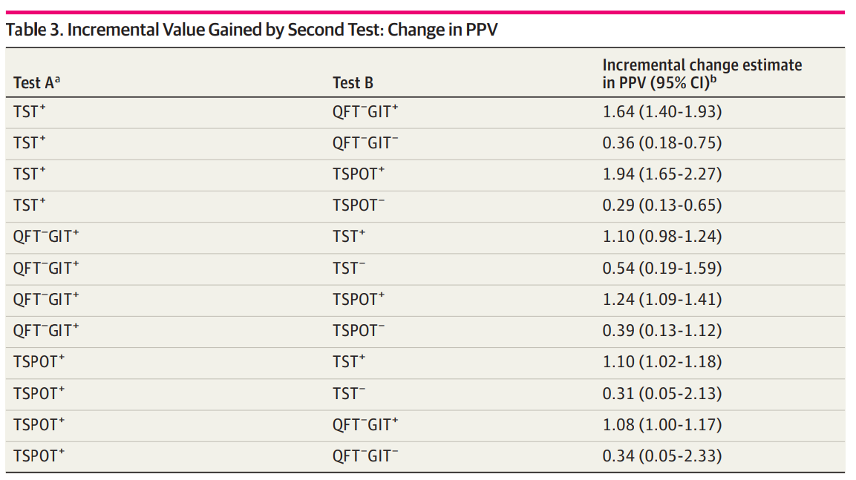
JAMA study with CDC (April 2024)
Prospective diagnostic trial of 22,000 subjects at high risk for TB infections
Compared TST & the two IGRA
Results of the second test are highlighted in red if it was positive and green if it was negative
(Table 3, Ayers 2024)

Slide 57
Learning points & take aways

Slide 58
Learning points & take aways
Nocardia is a G(+) branching rod, often found in soil, that can cause infections in immunocompromised hosts
Common sites of infection are skin and lungs, with a high predisposition to go to the CNS
Bactrim is a key back bone in multidrug therapy, which should be tailored to susceptibilities
Despite prolonged treatment (up to one year), high rates of recurrence
Nontuberculous mycobacterial (NTM) is everywhere, including water and soil
Epidemiological studies show higher rates in the south/gulf coast
Some NTM (e.g. M. ulcerans & M. marinum) have unique associations (e.g. fish tanks)
NTM can cause false positive PPDs (M. marinum)
If positive PPD (and low pretest probability), repeat IGRA may be of some utility
Sources

