Slide 1
Midbrain MAGIC
CID conference
Hunter Ratliff
10/03/2024
Ages, dates, and other identifying information may have been changed
I have no conflict of interest in relation to this presentation

Slide 2
Case #1

Slide 3
Case 1: HPI
A 73 y/o M with unclear PMH p/w falls & a right subdural hematoma

Slide 4
Case 1: HPI
A 73 y/o M with unclear PMH p/w falls & a right subdural hematoma
Week-long history of frequent falls, headache, and slurred speech
He was seen at OSH → CT showed R SDH → Txfr to Ruby
Admit to NSGY
Exam normal, non operative management
Not much documented for HPI or social history

Slide 5
Case 1: HPI
A 73 y/o M with unclear PMH p/w falls & a right subdural hematoma
Week-long history of frequent falls, headache, and slurred speech
He was seen at OSH → CT showed R SDH → Txfr to Ruby
Admit to NSGY
Exam normal, non operative management
Not much documented for HPI or social history
Hospital day 2: only A&Ox2
Ordered labs → CBC w/ leukocytosis
Repeat CTH stable

Slide 6
Case 1: HPI
A 73 y/o M with unclear PMH p/w falls & a right subdural hematoma
Week-long history of frequent falls, headache, and slurred speech
He was seen at OSH → CT showed R SDH → Txfr to Ruby
Admit to NSGY
Exam normal, non operative management
Not much documented for HPI or social history
Hospital day 2: only A&Ox2
Ordered labs → CBC w/ leukocytosis
Repeat CTH stable
Hospital day 3: Worsened mental status
Sent infectious workup (UA/UCx, BCx)
Started Vanco / Cefepime / Flagyl
Obtained MRI

Slide 7
Case 1: Initial workup
Vitals: Normal, bit hypertensive
Neuro exam: Normal (at first)

Slide 8
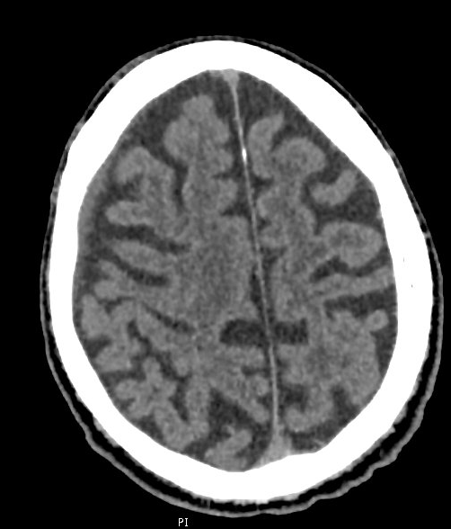
Case 1: Initial workup
Vitals: Normal, bit hypertensive
Neuro exam: Normal (at first)
CTH: 4mm right frontal SDH

Slide 9
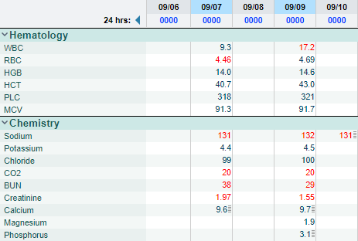
Case 1: Initial workup
Admit
HD1
HD2
HD3
Vitals: Normal, bit hypertensive
Neuro exam: Normal (at first)
CTH: 4mm right frontal SDH
A1c: 9.8
HIV screen: not obtained

Slide 10
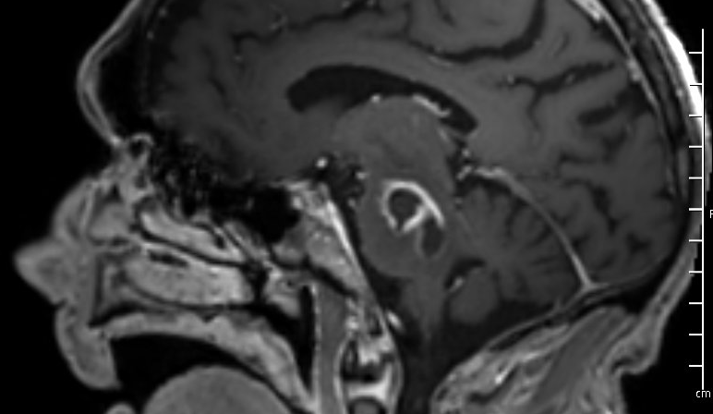
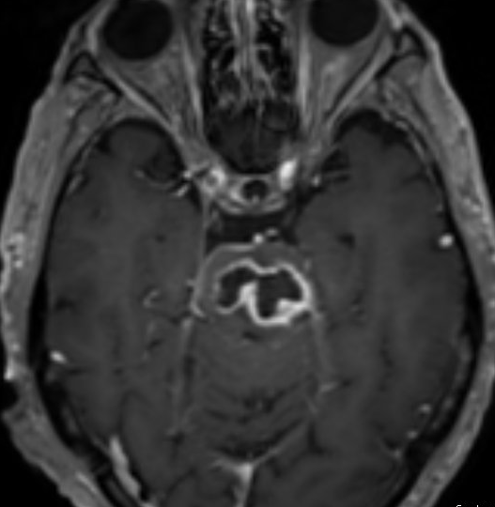
Case 1: MRI
Rim-enhancing lesion seen within the pons with associated internal restricted diffusion measuring up to 2.9 x 1.6 cm. On coronal post contrast sequences, there is ringlike enhancement seen along the left cortical spinal tract, with questionable restricted diffusion. There is extensive edema seen along the pons and midbrain. There is mass effect on the fourth ventricle without complete effacement or hydrocephalus.
T2 post contrast sequences

Slide 11
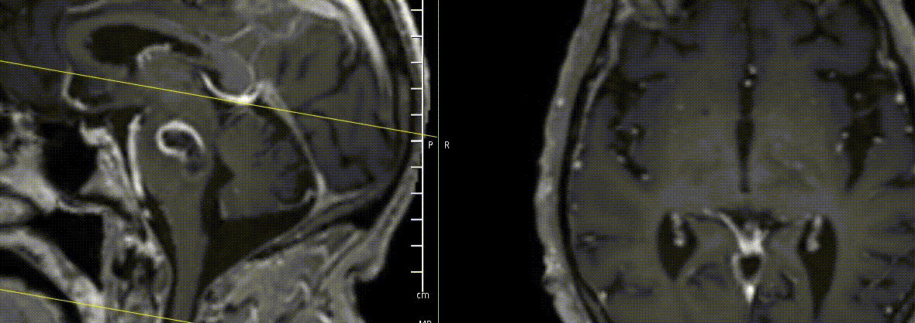
Case 1: MRI
T2 post contrast sequences

Slide 12
Case 1: MRI
Rim-enhancing lesion seen within the pons with associated internal restricted diffusion measuring up to 2.9 x 1.6 cm. On coronal post contrast sequences, there is ringlike enhancement seen along the left cortical spinal tract, with questionable restricted diffusion. There is extensive edema seen along the pons and midbrain. There is mass effect on the fourth ventricle without complete effacement or hydrocephalus.
T2 post contrast sequences

Slide 13
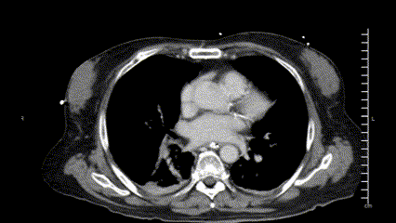
Case 1: Additional imaging
Due to concern for malignancy (glioma), CT C/A/P was obtained
CT C/A/P: Multiple ill-defined low-attenuation areas within the liver, which may be due to heterogeneous fatty infiltration, hepatocellular carcinoma or metastatic disease. MRI with liver mass protocol is recommended for further evaluation. Incompletely characterized on this study.

Slide 14
Case 1: Summary
-7 d
Falls
headache, slurred speech per EMR
A 73 y/o M with unclear PMH p/w falls headache, slurred speech x7 days
A1c: 9.8
MRI: 3cm pontine rim enhancing lesion. extensive edema in pons and midbrain. mass effect on the fourth ventricle
Admit
Admitted to NSGY
Day 2
Only A&Ox2
WBC 9 → 17
Day 3
Worsened mental status
MRI: 2.9 x 1.6 cm rim enhancing pontine lesion with edema
Started VAN / FEP/ MTZ
Liver hypoattenuation (incompletely characterized)
Day 4
OR for aspiration → NCCU
Intubated after OR in NCCU
Day 5
ID consulted

Slide 15
Case 1: Hospital course
Blood cultures positive for Listeria monocytogenes (prior to ID consult)
Advised NCCU to start ampicillin
OR cultures unsurprisingly grew Listeria as well
Still intubated when we signed off but…
Discharged on Ampicillin x 6 weeks

Slide 16
Discussion
QR CODE
Links to articles discussed here

Slide 17
Listeriosis
QR CODE
Objectives
Review trends in recent foodborne illnesses, with a focus on Listeria & recent outbreaks
Examine why Listeria is unique from other foodborne pathogens
Describe clinical manifestations & treatment

Slide 18
Foodborne illnesses
Over 200 known diseases capable of infecting humans via food / food products
Despite safety improvements, rates have been increasing in the US ^{[1.1]}
More complex food supply chains
Increasing demands → intensive farming
Climate change
Improved testing & reporting

Slide 19
Foodborne illnesses
Over 200 known diseases capable of infecting humans via food / food products
Despite safety improvements, rates have been increasing in the US ^{[1.1]}
More complex food supply chains
Increasing demands → intensive farming
Climate change
Improved testing & reporting
Common pathogens
Norovirus (58%)
Nontyphoidal Salmonella species (11%)
Campylobacter spp. (9%)
E coli
Listeria monocytogenes (1%)

Slide 20
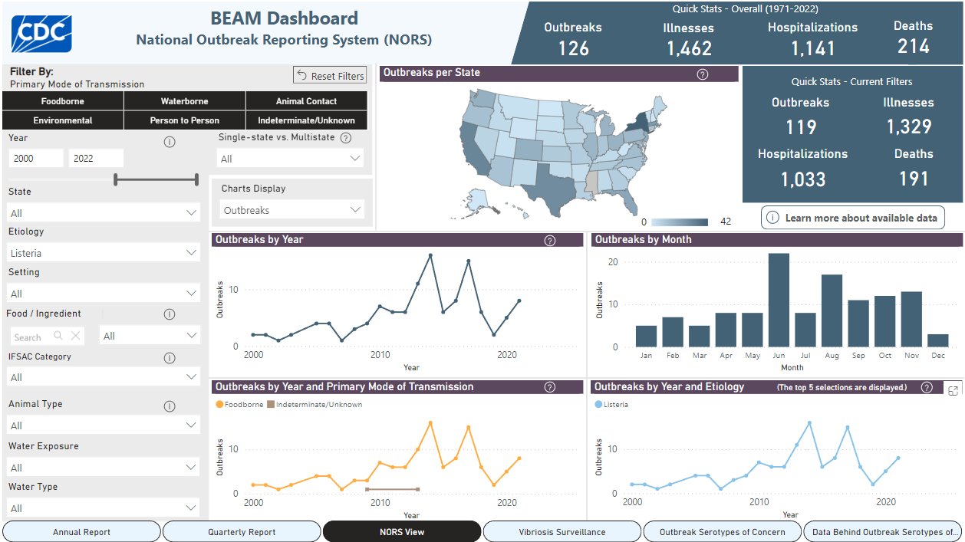
NORS (2000-2022) Listeria outbreaks ^{[3.2]}

Slide 21
Prior outbreaks of Listeria ^{[3.3]}
1985: Mexican cheese (52 deaths, over half were stillbirths/infants)
1998: Hot dogs & cold cuts (14 deaths, 4 miscarriages)
2002: 27 million pounds of turkey recalled (46 hospitalizations, 7 deaths, 3 miscarriages)
2007: Two deaths from contaminated milk
2011: Outbreak from cantaloupes (30 deaths). Spinach dip & salad bags were recalled separately
2015: Large recall of contaminated organic spinach
2016: Frozen food products from 40 different brands recalled (8 cases)
2018: Recall of organic nut mix
2023: Milkshakes (6 hospitalized, 3 deaths)
2024: Current outbreak (59 cases, 10 deaths)

Slide 22
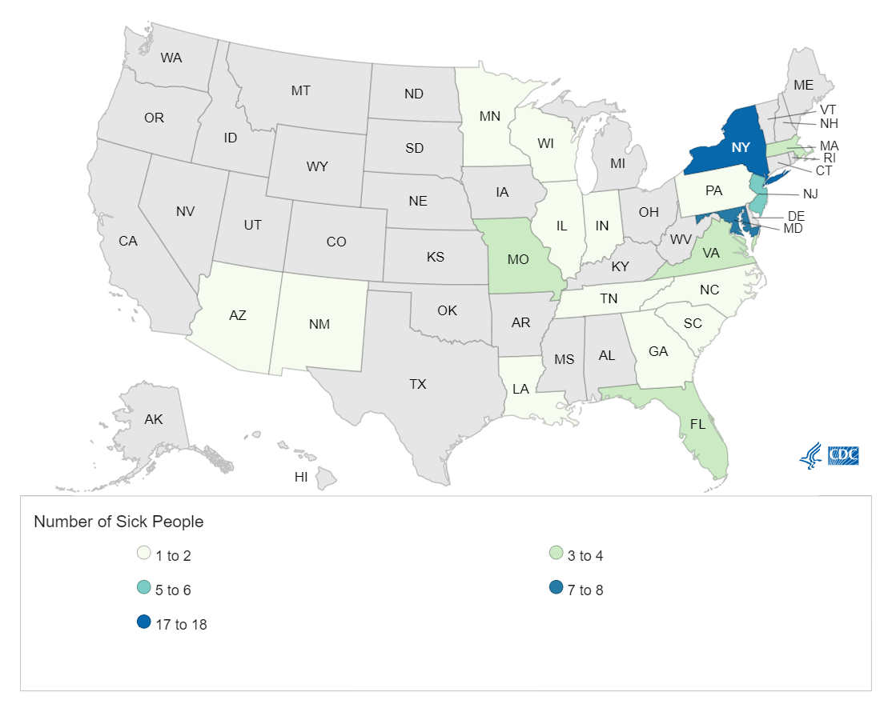
Current outbreak ^{[3.1]}
As of 9/23/24 (the last CDC update)*
59 cases across 19 states
10 deaths
Ages range from 32 to 95 years (median 78)
94% reported eating deli meats
95% reported eating meats sliced at a deli
Of the 44 people who answered if they ate liverwurst, 26 (59%) reported deli-sliced liverwurst before getting sick, and 19 reported Boar's Head brand
[3.4] CDC map from 2024 outbreak (accessed 10/1/24)
* Cases are from 5/29 - 8/28/24, sense it takes CDC time to do their work. So if this case was associated with this outbreak, it wouldn’t have shown up yet

Slide 23
Listeriosis
QR CODE
Objectives
Review trends in recent foodborne illnesses, with a focus on Listeria & recent outbreaks
Examine why Listeria is unique from other foodborne pathogens
Describe clinical manifestations & treatment

Slide 24
Listeria: Microbiology
Small intracellular gram positive bacillus often in chains
Non-motile at 37°C but has tumbling motility at 22-25°C
Grows best on blood agar & tryptose phosphate agar
Isolated from milk & cheese products, meat
Unique in that it can survive harsh conditions, in large part due to biofilm production ^{[1.2]}
Low temperatures ( −0.4 to 50 °C) and pH (4.6–9.5)
High salt concentrations (10–2%)
Low water concentrations
Biofilm production is linked to:
Temperature: Low temp → increased flagella activity → increased biofilm
Nutrient availability: Being on stainless steel increases biofilm production

Slide 25
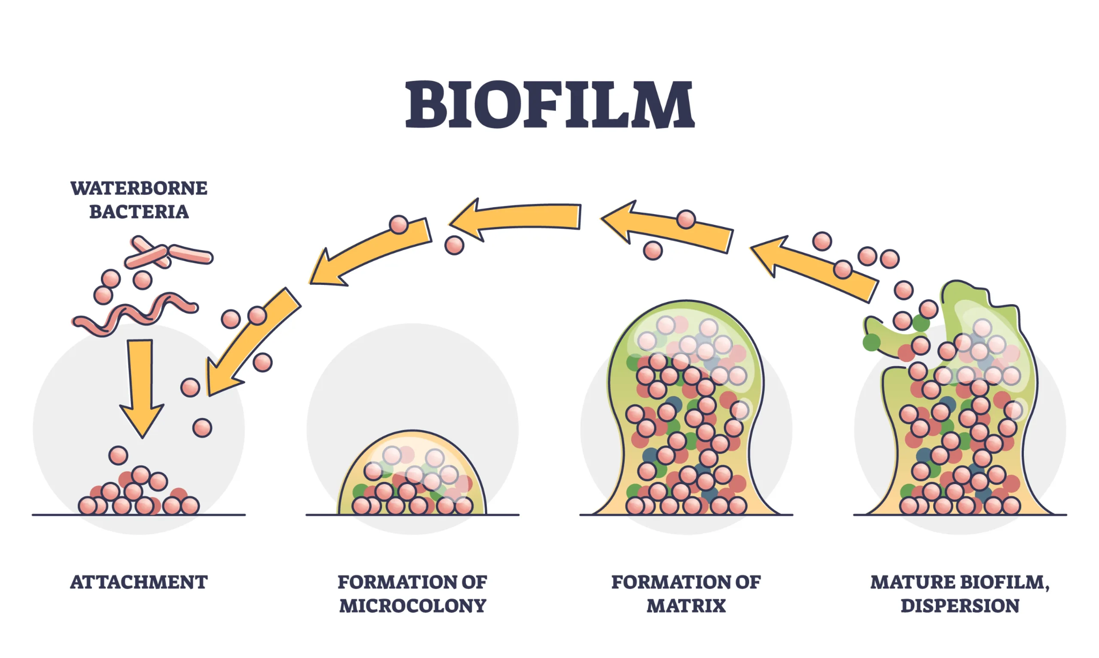
Listeria: Microbiology
Small intracellular gram positive bacillus often in chains
Non-motile at 37°C but has tumbling motility at 22-25°C
Grows best on blood agar & tryptose phosphate agar
Isolated from milk & cheese products, meat
Unique in that it can survive harsh conditions, in large part due to biofilm production ^{[1.2]}
Low temperatures ( −0.4 to 50 °C) and pH (4.6–9.5)
High salt concentrations (10–2%)
Low water concentrations
Biofilm production is linked to:
Temperature: Low temp → increased flagella activity → increased biofilm
Nutrient availability: Being on stainless steel increases biofilm production

Slide 26
Listeria: Microbiology
Small intracellular gram positive bacillus often in chains
Non-motile at 37°C but has tumbling motility at 22-25°C
Grows best on blood agar & tryptose phosphate agar
Isolated from milk & cheese products, meat
Unique in that it can survive harsh conditions, in large part due to biofilm production ^{[1.2]}
Low temperatures ( −0.4 to 50 °C) and pH (4.6–9.5)
High salt concentrations (10–2%)
Low water concentrations
Biofilm production is linked to:
Temperature: Low temp → increased flagella activity → increased biofilm
Nutrient availability: Being on stainless steel increases biofilm production
Biofilm production makes it harder for disinfectants to work

Slide 27
Listeriosis
QR CODE
Objectives
Review trends in recent foodborne illnesses, with a focus on Listeria & recent outbreaks
Examine why Listeria is unique from other foodborne pathogens
Describe clinical manifestations & treatment

Slide 28
Listeria: Transmission & manifestations
Transmission
Gastrointestinal → blood stream
Vertical: Maternal GI → hematogenous to fetus
Low infectious dose (~100 bacteria) needed to infect immunocompromised
Incubation period has wide variety (3 days to 10 weeks) ^{[3.1]}
Limited febrile gastroenteritis: Mainly in immunocompetent
Invasive listeriosis: Mainly in immunocompromised
Bloodstream infection with sepsis w/ meningitis
High mortality (~25%)
Pregnancy: Usually mild illness for the mother, but can cause preterm labor, fetal sepsis, and fetal demise

Slide 29
Listeria: Transmission & manifestations
Transmission
Gastrointestinal → blood stream
Vertical: Maternal GI → hematogenous to fetus
Low infectious dose (~100 bacteria) needed to infect immunocompromised
Incubation period has wide variety (3 days to 10 weeks) ^{[3.1]}
Limited febrile gastroenteritis: Mainly in immunocompetent
Invasive listeriosis: Mainly in immunocompromised
Bloodstream infection with sepsis w/ meningitis
High mortality (~25%)
Pregnancy: Usually mild illness for the mother, but can cause preterm labor, fetal sepsis, and fetal demise

Slide 30
Basilar CNS infection
DDx of basilar meningitis / abscesses ^{[1.3] [3.5] [Guilfoose]}
Tuberculosis
Fungal: Crypto, histo
Spirochetes: Lyme, syphilis
Listeria
Granulomatous disease
Neurosarcoidosis, leptomeningeal carcinomatosis, lymphoma
Some association with these infections and CN palsy & increased ICP ^{[3.5]}

Slide 31
Listeria: Treatment
Ampicillin, penicillin, gentamicin and TMP-SMX are active
Inherently resistant to cephalosporins
Ampicillin is the drug of choice
Mixed reports on if meropenem can be used for meningitis

Slide 32
Case #2

Slide 33
Case 2: HPI
A 65 y/o F with PMH including PAD (left ax-SFA bypass 12/2019, left AKA 8/2021), s/p CABG, CVA, DVT, chronic sacral decubitus ulcer, rectovaginal fistula s/p diverting colostomy, chronic SPC p/w bleeding from her graft.

Slide 34
Case 2: HPI
A 65 y/o F with PMH including PAD (left ax-SFA bypass 12/2019, left AKA 8/2021), s/p CABG, CVA, DVT, chronic sacral decubitus ulcer, rectovaginal fistula s/p diverting colostomy, chronic SPC p/w bleeding from her graft.
Sent from vascular clinic for exposed graft on left chest that has been bleeding for weeks/months
Mostly bloody but occasionally purulent on her anterior chest wall
No antibiotics prior to admission

Slide 35
Case 2: Background
A 65 y/o F with PMH including PAD (left ax-SFA bypass 12/2019, left AKA 8/2021), s/p CABG, CVA, DVT, chronic sacral decubitus ulcer, rectovaginal fistula s/p diverting colostomy, chronic SPC p/w bleeding from her graft.
2006
2019
2021
2023
2024
Endometrial cancer
Left Ax-SFA Bypass (Teflon)
Left AKA for graft occlusion
& sacral wound
SBO, MRSA bacteremia
Bleeding from graft
s/p hysterectomy
Recurred in 2009 and required XRT
Placed for radiation-induced ischemia to left common/external iliac arteries
VRE UTI
1 month later treated for AKA stump infection & sacral wound
Treated w/ 6 weeks of dapto
Sent from vascular clinic, unclear chronicity

Slide 36
Case 2: HPI

Slide 37
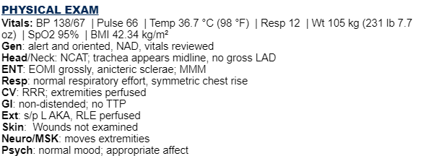
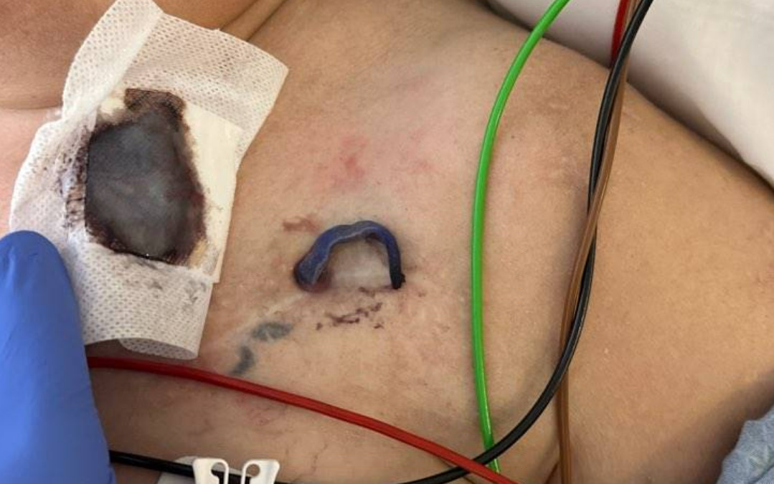
Case 2: Exam

Slide 38
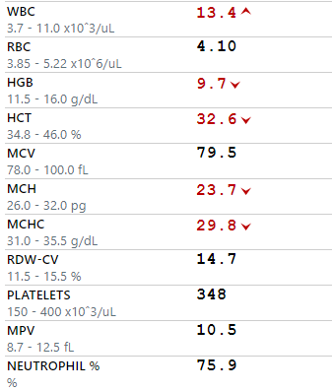
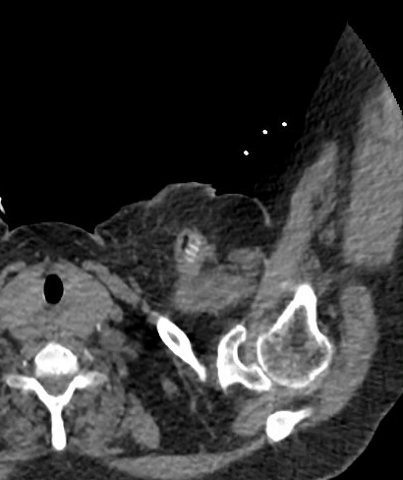
Case 2: Initial Workup
CTA C/A/P: Inflammatory changes are noted surrounding proximal remnant of the left axillary-femoral bypass graft with trace foci of air seen adjacent to graft in left upper chest. No flow is seen within the graft. Multifocal atherosclerotic disease. The SMA, celiac artery,
bilateral renal arteries are patent.
Occlusion of the left
common/external/internal iliac
arteries and proximal aspect of
the left common femoral artery
as well as the left superficial
femoral artery.

Slide 39
Case 2: Operative Note
The incision was made over the area of the wound. The bypass graft was found and the distal portion was easily removed from its tract due to significant perigraft purulence. Cultures were taken. We continued our dissection distal to the graft and identified the axillary artery distal to the anastomosis. The artery was then controlled with silastic vessel loops.
We then dissected around the graft to the level of the anastomosis. The graft was well incorporated proximally and dissection was difficult. The anastomosis did not appear to be infected and appeared to be well incorporated. The graft was then transected 2-3 mm above the anastomosis. Using a 4 0 Prolene suture the graft and surrounding tissue were oversewn in 2 layers. Cultures were taken at the level of the anastomotic stump.
Using a curette the graft tract was debrided in the chest wall. A counter incision was made in the lateral chest wall at the level of the distal graft site. A 2nd incision was made inferior to our axillary wound. Using a DeBakey vascular clamp a Penrose drain was passed between these 2 incisions in the tract of the previous bypass graft and secured. The wound was then irrigated. A 14 French flat JP drain was placed in the deep space above the arterial repair. Using a 2-0 Vicryl suture the deep layer was closed in an interrupted fashion.
Left axillary artery cutdown with explant of previous bypass graft with primary repair of left axillary artery
Findings: Purulence found in the previous axillary to femoral bypass graft tract distal to the anastomosis. The area near the anastomosis was well incorporated and did not appear to be infected. Post resection of the bypass graft and over-sewing of the anastomosis images revealed a patent axillary artery with no significant stenosis.
Implants: None

Slide 40
Case 2: Summary
2019
Left Ax-SFA bypass
10/2021
Left AKA, sacral wound
Urine: VRE
Sacrum: Kleb pneumo (x2), glabrata, mixed
A 65 y/o F with PMH including PAD (left ax-SFA bypass 12/2019, left AKA 8/2021), chronic sacral decubitus ulcer, rectovaginal fistula, chronic SPC p/w bleeding from her graft.
12/2021
Stump infection
OR: Kleb pneumo, CONS, VRE, E cloacae, anaerobes
02/2024
Unclear Culture? (outpatient)
Ordered outpatient as “LEFT AXILLARY GRAFT C&S”
Grew Corynebacterium & Achromobacter
07/2023
SBO, MRSAB
Blood: MRSA, CONS
Now
Current admission

Slide 41
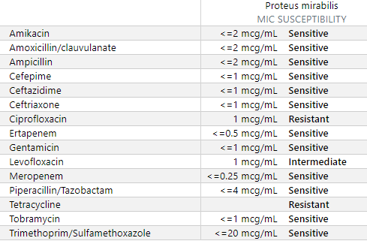
Micro data
The incision was made over the area of the wound. The bypass graft was found and the distal portion was easily removed from its tract due to significant perigraft purulence. Cultures were taken. We continued our dissection distal to the graft and identified the axillary artery distal to the anastomosis. The artery was then controlled with silastic vessel loops.
We then dissected around the graft to the level of the anastomosis. The graft was well incorporated proximally and dissection was difficult. The anastomosis did not appear to be infected and appeared to be well incorporated. The graft was then transected 2-3 mm above the anastomosis. Using a 4 0 Prolene suture the graft and surrounding tissue were oversewn in 2 layers. Cultures were taken at the level of the anastomotic stump.
Using a curette the graft tract was debrided in the chest wall. A counter incision was made in the lateral chest wall at the level of the distal graft site. A 2nd incision was made inferior to our axillary wound. Using a DeBakey vascular clamp a Penrose drain was passed between these 2 incisions in the tract of the previous bypass graft and secured. The wound was then irrigated. A 14 French flat JP drain was placed in the deep space above the arterial repair. Using a 2-0 Vicryl suture the deep layer was closed in an interrupted fashion.
BCx: NGTD
OR (L axillary artery): Proteus mirabilis (<5 cfu)
OR (Left Axillary Incision wound):

Slide 42
Case 2: Hospital course
Initially on Vanc & Zosyn
Switched to ceftriaxone by ID
AKI on CKD, required some CRRT post op
Discharged on Augmentin
Plans to suppress since some graft still in place

Slide 43
Discussion
QR CODE
Links to articles discussed here

Slide 44
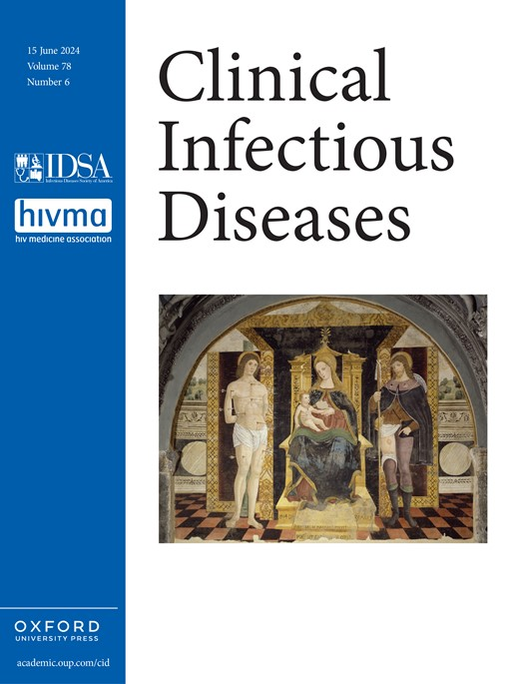
Vascular Graft Infections (VGI)
QR CODE
Objectives
Accurately diagnose & categorize (suspected & confirmed) VGIs
Describe surgical management
Review treatment options & duration
DeSimone et al (2024)
Clinical Infectious Diseases [citation 2.1]

Slide 45
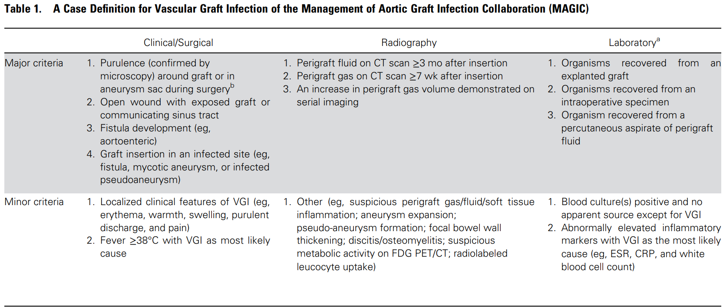
✨MAGIC✨
Management of Aortic Graft Infection Collaboration 🪄

Slide 46
Suspected VGI
One major – or –
Minor from 2 of 3 categories
Confirmed VGI
One major – plus – any other criterion (major or minor) from
another category

Slide 47
VGI: Diagnosis
Radiological criteria
CTA is the main stay
Perigraft gas/fluid after 2-3 months are highly suggestive of VGI
WBC scintigraphy & PET/CT are best
Meta-analysis ^{[2.2]} showed WBC SPECT/CT out performed FDG-PET/CT
Laboratory criteria
2/3rd of cases are gram positive (CONS, SA, enterococci) ,1/3rd are gram negative
Often negative due to antibiotics
May be some role for 16S rRNA or broad-range bacterial-PCR

Slide 48
VGI: Extent of infection
Samson classification: distinguishes between infection limited to skin and soft tissue vs. reaching vascular prosthesis
Group I: Infection limited to dermis
Group II: Infection of subcutaneous tissue without direct contact with the graft
Group III: Infection reaching body of the graft but not anastomosis
Group IV: Exposed anastomosis, no bleeding, no bloodstream infection
Group V: Anastomosis involved, bleeding, bloodstream infection
VGI

Slide 49
Vascular Graft Infections (VGI)
QR CODE
Objectives
Accurately diagnose & categorize (suspected & confirmed) VGIs
Describe surgical management
Review treatment options & duration
DeSimone et al (2024)
Clinical Infectious Diseases [citation 2.1]

Slide 50
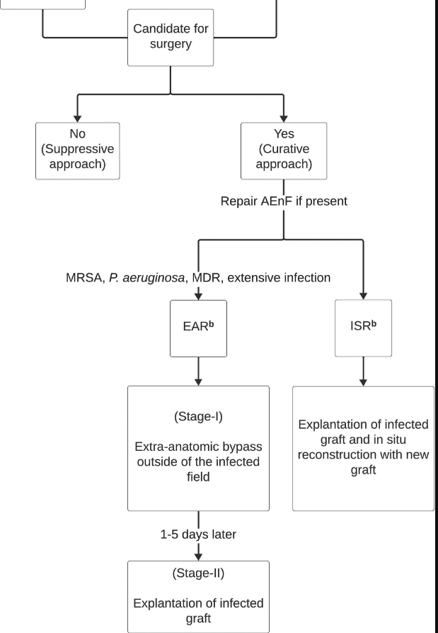
VGI: Surgical management
Graft explant should be done, if a candidate
18-30% mortality w/ graft explant
2 year mortality approaches 100% if not explanted
The authors consider partial explant to be conservative/suppressive approach
EAR
extra-anatomic reconstruction
ISR
in situ reconstruction

Slide 51
VGI: Surgical management
Graft explant should be done, if a candidate
18-30% mortality w/ graft explant
2 year mortality approaches 100% if not explanted
The authors consider partial explant to be conservative/suppressive approach
ISR is now preferred technique early mortality, amputations, graft occlusion, and overall reinfection
EAR may be preferred for difficult-to-treat pathogens or presence of extensive perigraft infection to avoid reconstruction in a heavily contaminated field
EAR
extra-anatomic reconstruction
ISR
in situ reconstruction

Slide 52
VGI: Extent of infection
Samson classification: distinguishes between infection limited to skin and soft tissue vs. reaching vascular prosthesis
Group I: Infection limited to dermis
Group II: Infection of subcutaneous tissue without direct contact with the graft
Group III: Infection reaching body of the graft but not anastomosis
Group IV: Exposed anastomosis, no bleeding, no bloodstream infection
Group V: Anastomosis involved, bleeding, bloodstream infection
High risk of VGI
VGI
Must be explanted
(no “conservative management”)

Slide 53
Vascular Graft Infections (VGI)
QR CODE
Objectives
Accurately diagnose & categorize (suspected & confirmed) VGIs
Describe surgical management
Review treatment options & duration
DeSimone et al (2024)
Clinical Infectious Diseases [citation 2.1]

Slide 54
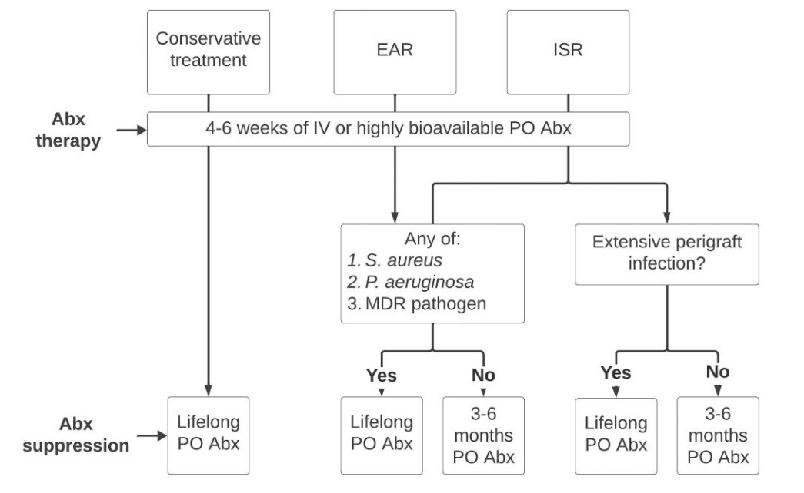
VGI: Duration of treatment
extra-anatomic reconstruction
in situ reconstruction

Slide 55
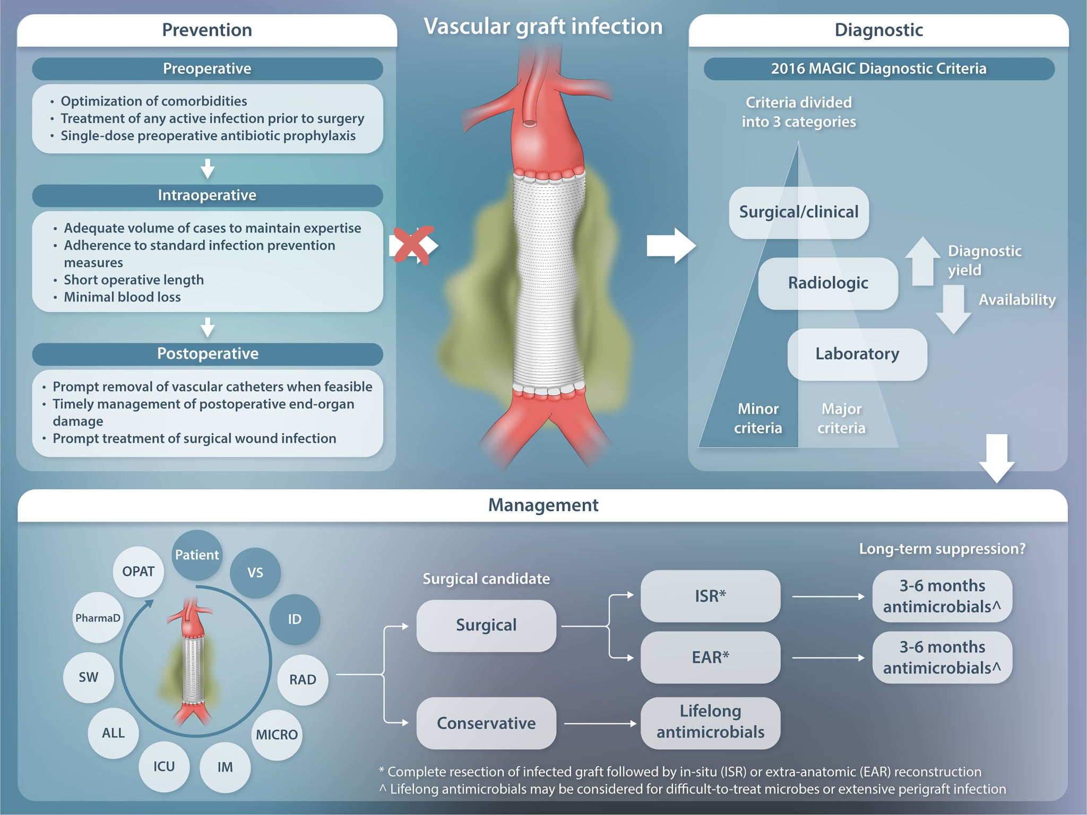
DeSimone et al (CID, 2024)

Slide 56
Learning points & take aways

Slide 57
Learning points & take aways
QR CODE
Rates of foodborne illness have been increasing due to multiple factors (supply chain, intensive farming, climate change, improved surveillance)
Listeria is an uncommon, but deadly foodborne pathogen in part due to biofilm production
Basilar CNS infections are associated with listeriosis, in addition to TB, fungal, spirochetes, & other granulomatous processes
Vascular graft infections (VGI) are defined & classified by the MAGIC criteria🪄 & Samson classification, respectively
Lifelong antibiotics may be needed for VGIs, depending on surgical approach (extra-anatomic vs in situ reconstruction), the pathogen identified, and extent of infection
Slides available on hunterratliff1.com/talk/; Citations available via QR code or via the “citations” button on the website

